Slide 1
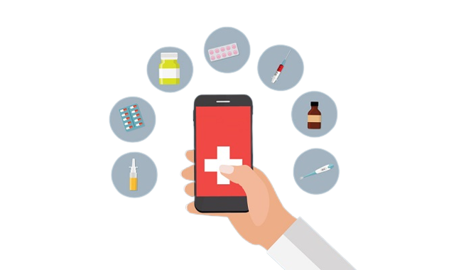
Personalized Mobile Patient Guidance System For
Early Detection and Management of
Metabolic Syndrome

Slide 2
Team Details
Project ID : TMP-23-226
Supervisor : Ms. Sanjivi Chandrasiri
Co supervisor : Ms. Suriyaa Kumari
 | STUDENT NAME | STUDENT NO. | CONTACT NO. | EMAIL ADDRESS
1 | Udayantha Yapa Y.M. S | IT20045708 | 0775472705 | IT20045708@my.sliit.lk
2 | Dissanayaka D.M.R. A | IT20264048 | 0779963878 | IT20264048@my.sliit.lk
3 | Herath H.M.T. P | IT20276850 | 0716381037 | IT20276850@my.sliit.lk
4 | Peiris B.M. G | IT20147396 | 0711798124 | IT20147396@my.sliit.lk

Slide 3
Introduction
Highlight the high incidence rate and associated health risks of metabolic syndrome to underscore the necessity of a solution like the personalized automated health guidance system.
A personalized automated health advice system providing to people can evaluate their health with great efficiency.
Management of report analysis/scanning using advanced algorithms and machine learning techniques
Real-time monitoring of vital signs for early identification of potential health issues.
Provides more accurate and effective recommendations for managing the food plans and exercise plans .
delivers a tailored health profile for the manager; they live a healthy lifestyle and enjoy a healthy existence.

Slide 4
Research Problem
What can we do to prevent metabolic syndrome in people?
Metabolic syndrome is a combination of symptoms that increase the risk of several health complications such as heart disease, stroke, non-alcoholic fatty liver disease, peripheral vascular disorders, MI, and type 2 diabetes.
Traditional care for metabolic syndrome involves medication and lifestyle modifications, but adherence to these interventions can be challenging for many people.
The research project aims to determine whether a personalized, automated health guidance system can help people manage their metabolic syndrome by providing them with real-time, evidence-based support.
The study will assess the effectiveness of the personalized health guidance system in terms of adherence to lifestyle changes, changes in vital signs, a decrease in the risk of complications, and an improvement in quality of life.
The ultimate goal of the study is to help people with metabolic syndrome achieve better health outcomes by providing them with the information and support they need to manage and improve their condition.

Slide 5
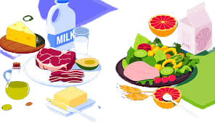
Objectives
Main Objective
The goal is to create a personalized health guidance system for metabolic syndrome using machine learning, customized health plans, and motivational messaging.
The system aims to improve overall health and reduce the risk of concomitant diseases by monitoring health parameters in real-time.

Slide 6
Sub Objective
medical records to track and monitor health metrics like blood pressure, blood sugar levels, fasting triglyceride levels, cholesterol levels, and steps taken in real-Time.
Monitor the individual's progress and adjust the health plan accordingly to ensure optimal results.
Using goal-setting tools and tracking technologies, offer individualized advice on exercise and diet. To encourage adherence to the health plan, provide daily reminders and inspirational messages.
Implement a system that provides individualized diet and exercise plans based on a person's medical history, level of physical activity, and dietary habits.

Slide 7
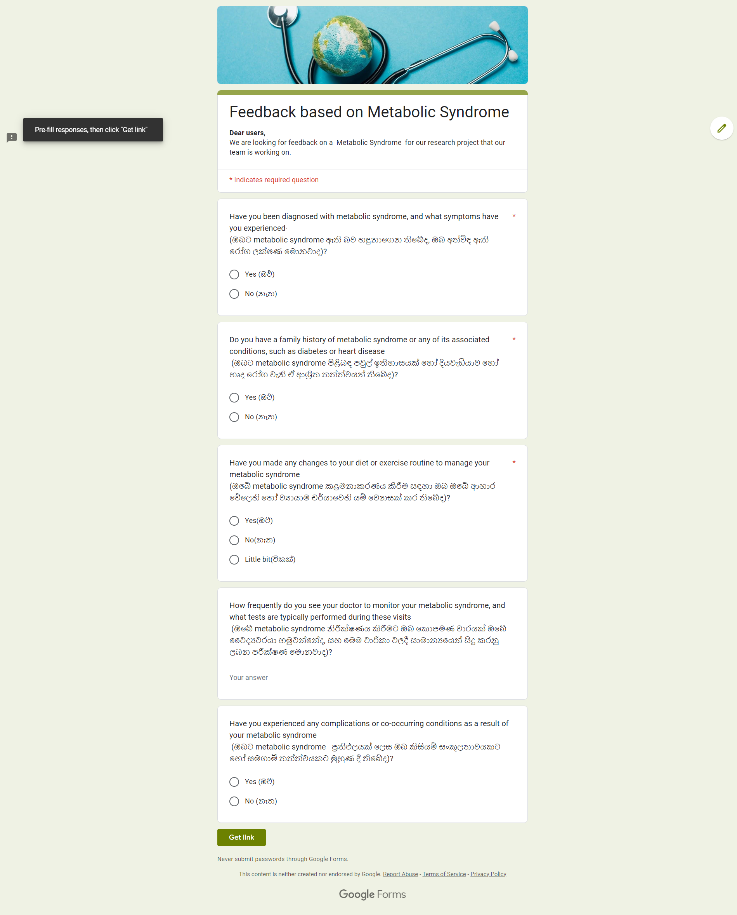
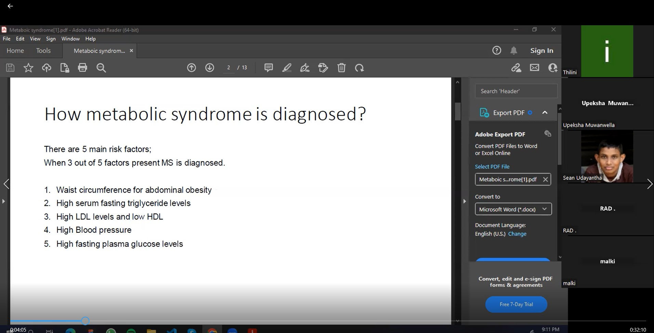
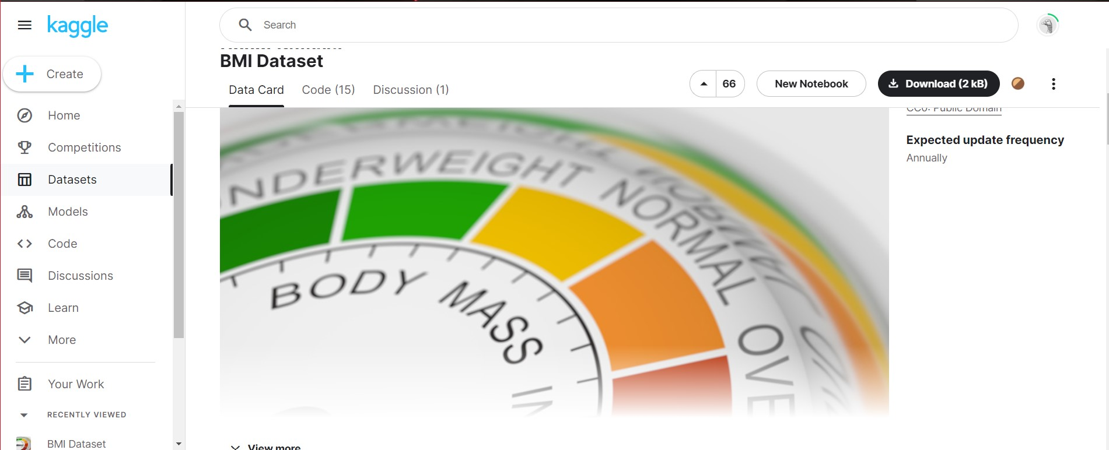
Data Gathering
Mainly gathered data from three forms.
Conducted a Zoom meeting with a doctor to get information about metabolic syndrome.
Collected data randomly from people through a Google form.
Collected datasets from research papers and online sites(e.g.: Kaggle)

Slide 8
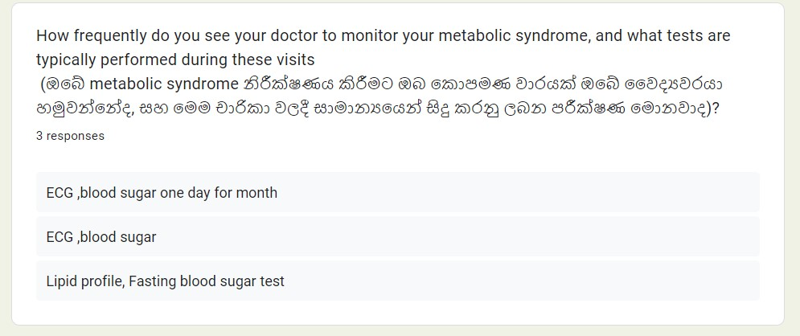
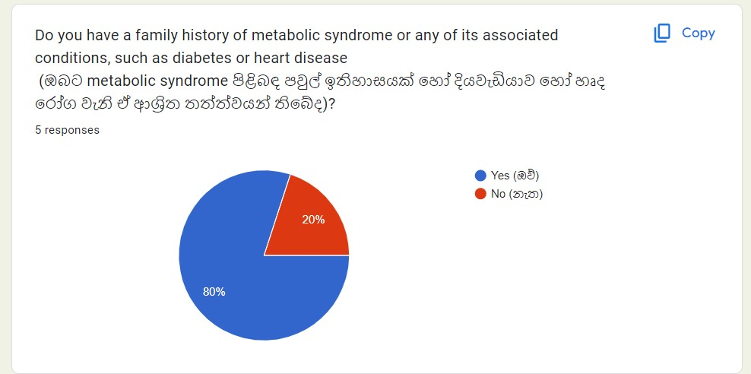
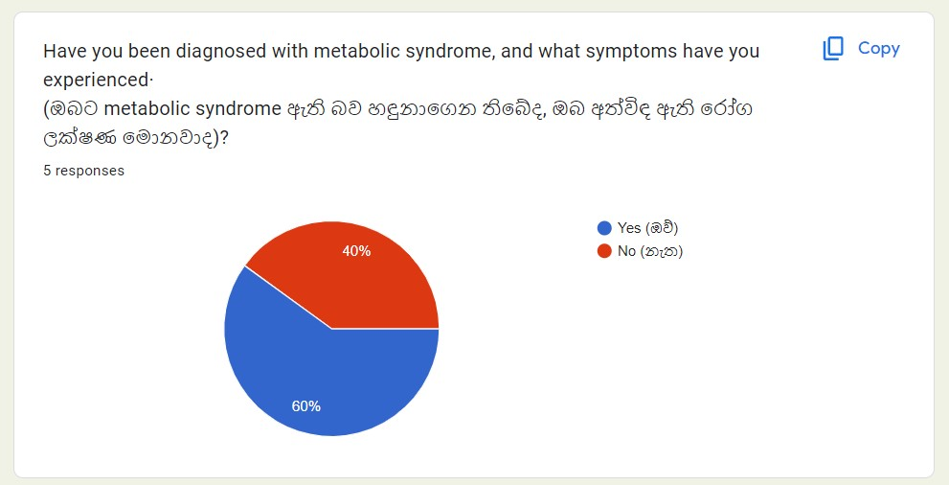
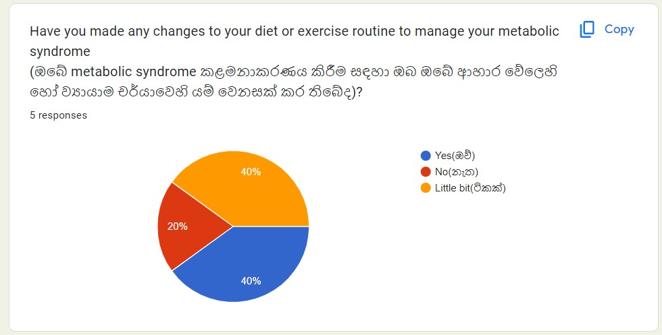
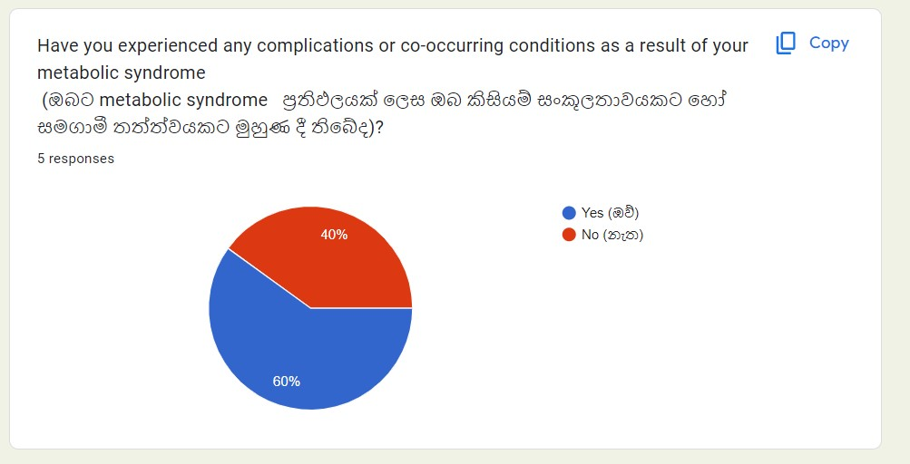
Data Gathering
Collected data randomly from people
We're taking random data from people to get the knowledge they have about metabolic syndrome and what they're doing to prevent metabolic syndrome.

Slide 9
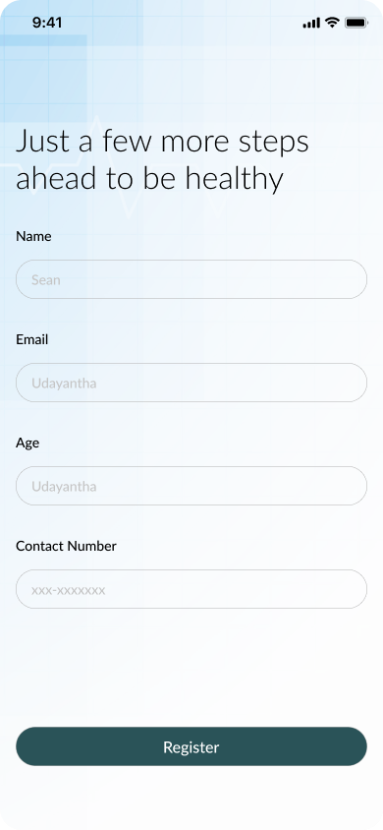
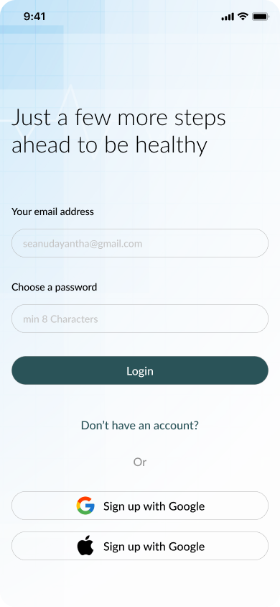
Future Achievements
1)We will plan to apply 2 different methods to give health recommendations and Suggestions,
Food recommendations
Exercise recommendations
2)We will plan to give above 2 different recommendations based on weight of the prediction
EX 1: if the system gives 80% of high obesity level for chubby person ,then system will select what are the Food recommendations and Exercise recommendations based on above 80% prediction level.
EX 2: if the system gives 20% of low cholesterol level for any person ,then system will select what are the Food recommendations and Exercise recommendations based on above 20% prediction level.
3)Develop the UI/UX parts of the Mobile Application .

Slide 10

Udayantha Yapa Y.M.S
IT200445708
BSc (Hons)
in
Information Technology Specializing in Software Engineering

Slide 11


Research Component
Management Of Report Analysis and Scanning

Slide 12

Background
Management of report analysis/scanning is a vital component of our proposed personalized automated health guidance system for metabolic syndrome.
The system will use advanced algorithms and machine learning techniques to analyze patient data, identify patterns and trends, and provide more accurate and effective recommendations for managing the condition.
The goal of this component is to improve the accuracy of patient profiles and enable healthcare providers to access timely and accurate information about their patients.
By updating patient profiles according to their current status, the system can provide personalized guidance that is always up to date and reflective of their current health status.

Slide 13
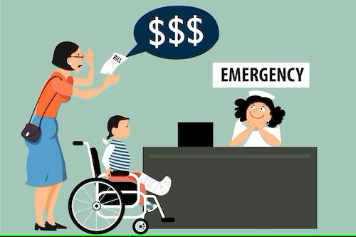
Research problem
How can we identify and extract relevant data from patient reports, such as blood pressure readings, blood glucose levels, and cholesterol/triglyceride levels?
How can we ensure the privacy and security of patient data during the scanning and analysis process, and what measures can be put in place to protect against data breaches?
What impact does the integration of report analysis/scanning into a personalized automated health guidance system have on patient outcomes, such as adherence to treatment plans, improvements in vital signs, and reduction in the risk of complications?
What machine learning techniques can be used to identify patterns and trends in patient data, and how can we optimize these techniques for the specific needs of people with metabolic syndrome?

Slide 14

Methodology
System overview Diagram.
Technology Involved
Requirements
WBS

Slide 15
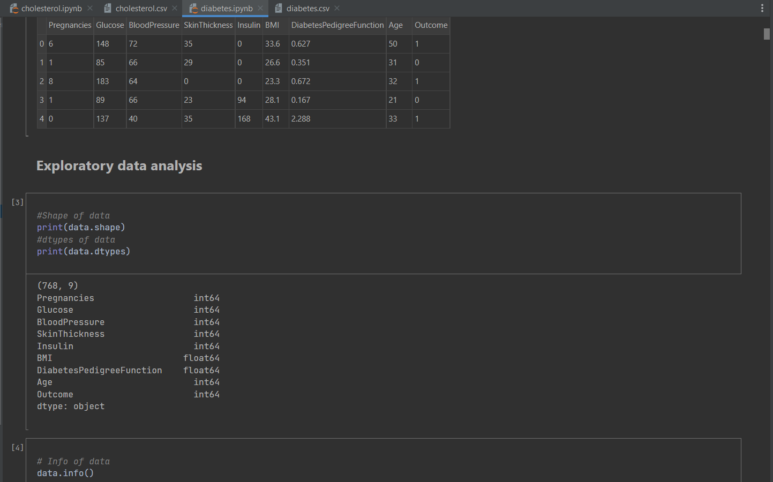
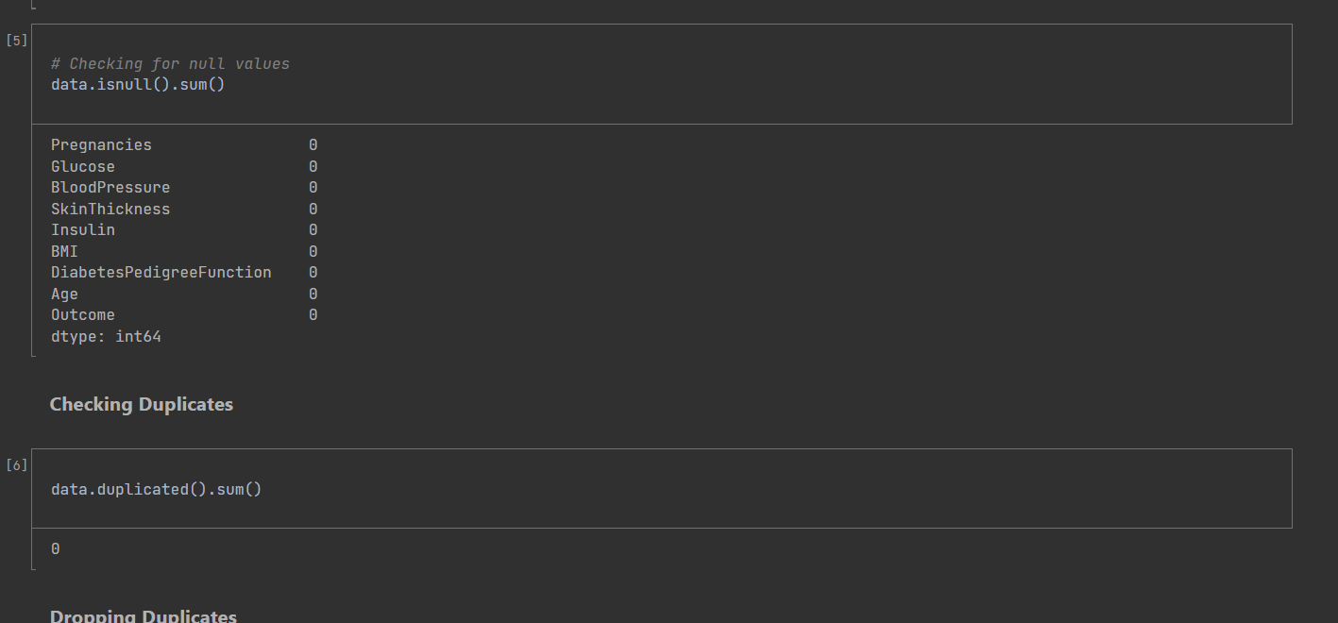
We gathered suitable dataset from the Kaggle website.
Title : Diabetes Prediction
how affect for metabolic syndrome Diabetes, that’s why I selected to train this model.
Status :
0 --> less chance
1 --> more chance
Methodology
Import data CSV file
Model preparation
Y is the dependent variable
Y = outcome
X is the independent variable
X = all the other variables except the output (Pregnancies,Glucose,…)
Exploratory data analysis

Slide 16
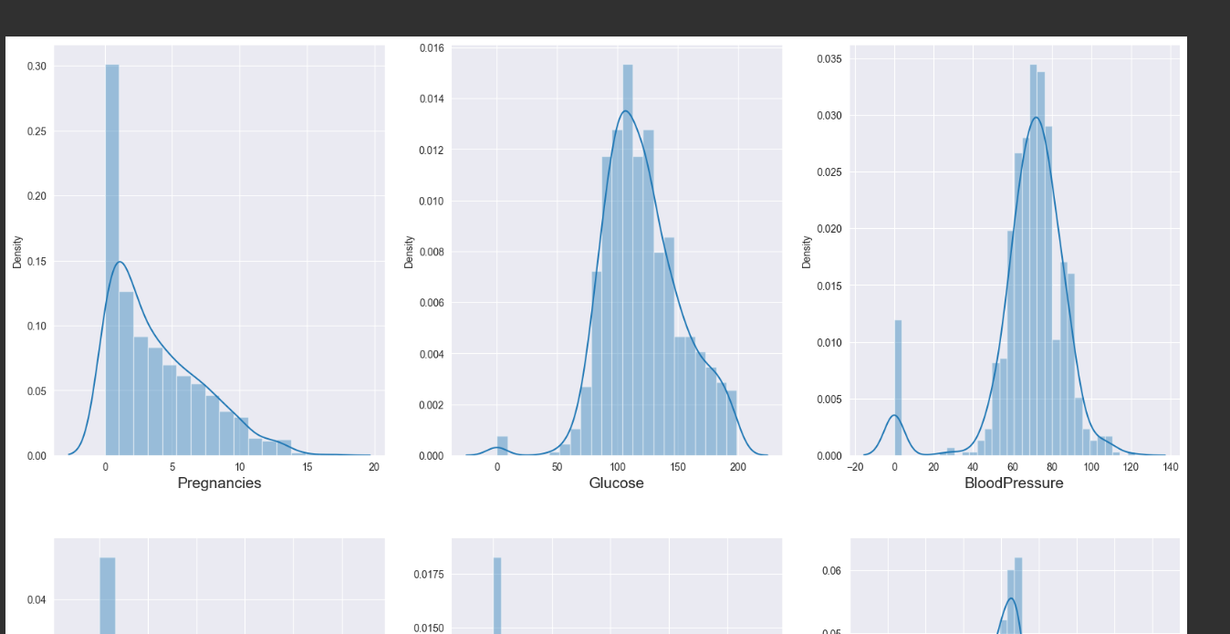
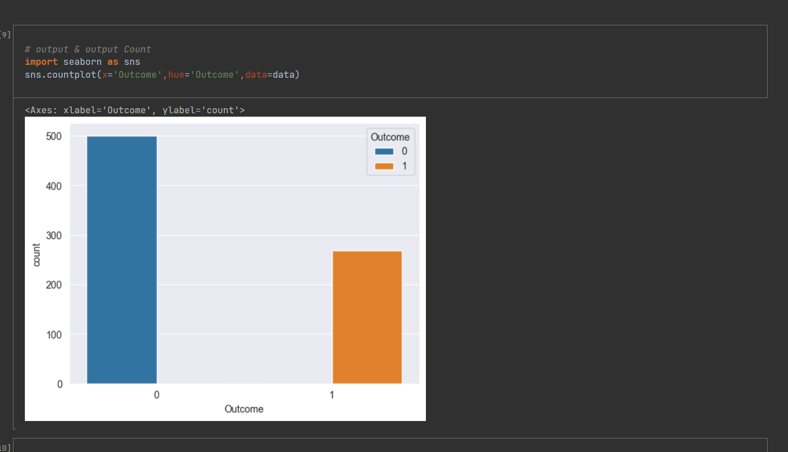
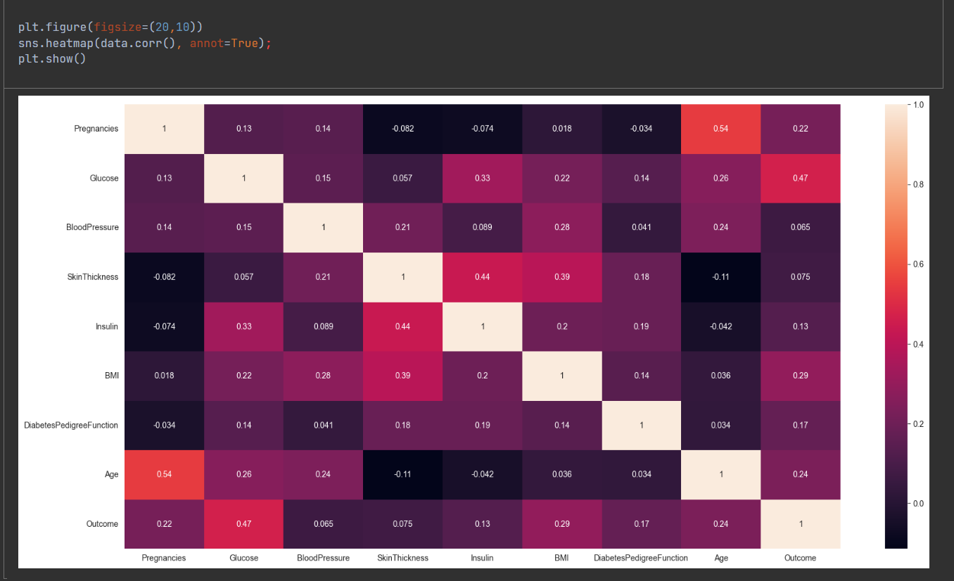
Data visualization part
We can see that the distribution of data is normal ! lets move for the Model preparation.

Slide 17
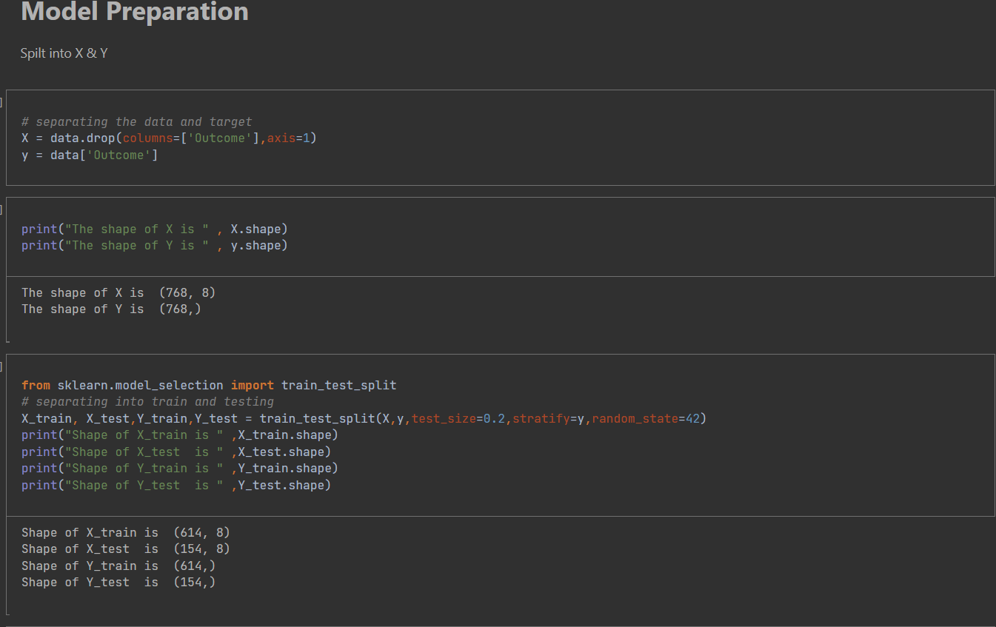
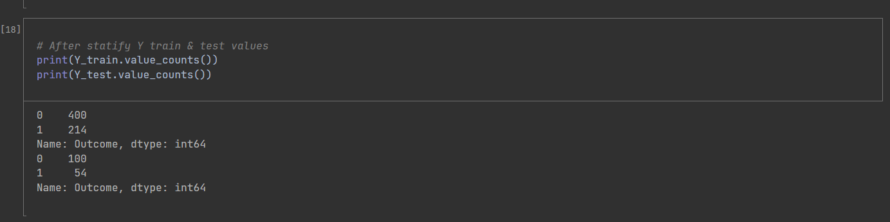
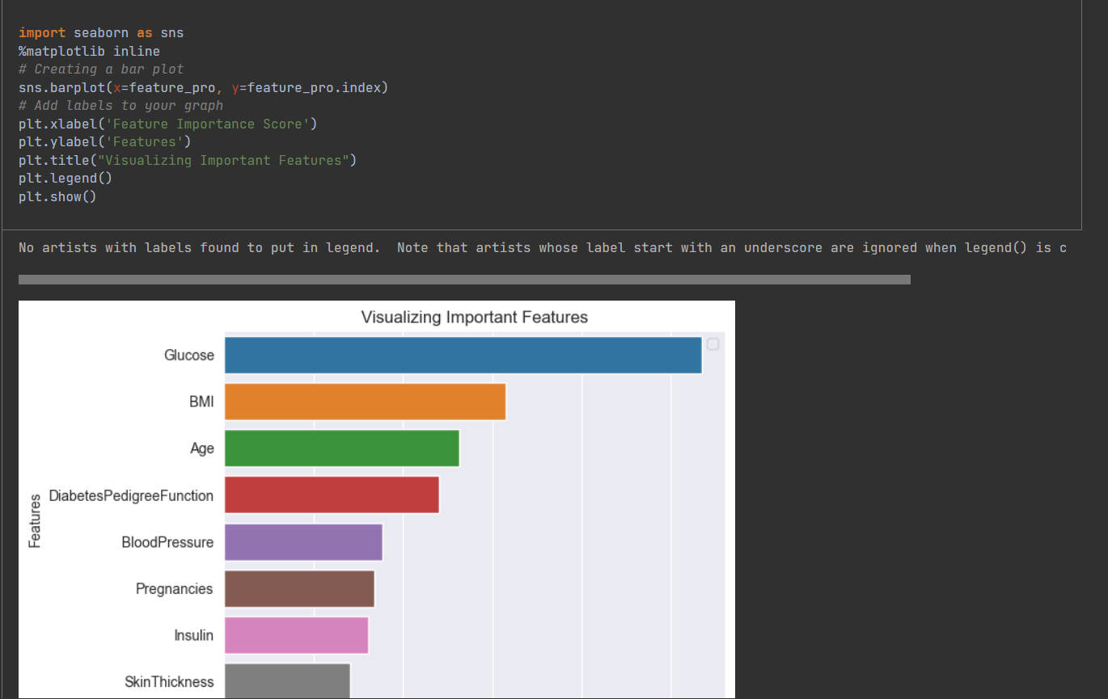
Module preparation
Set X and Y values
Separate data set to test values and train values
Feature Importance's Visualizing

Slide 18
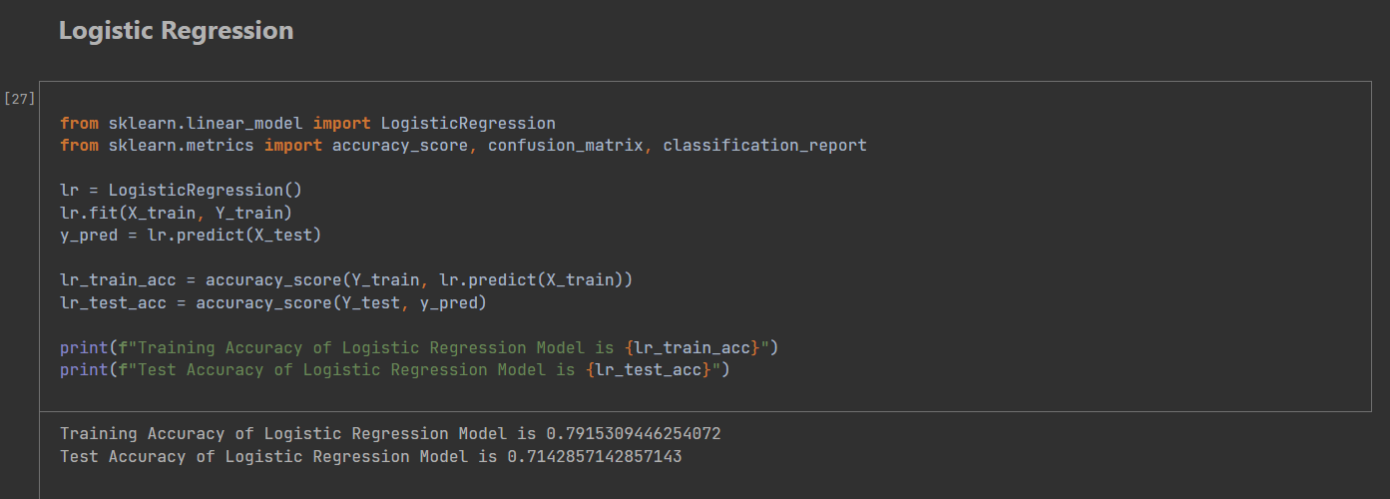
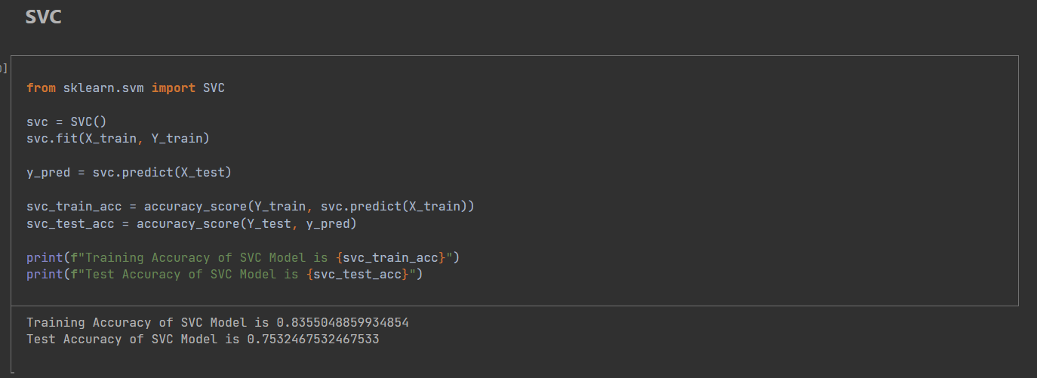
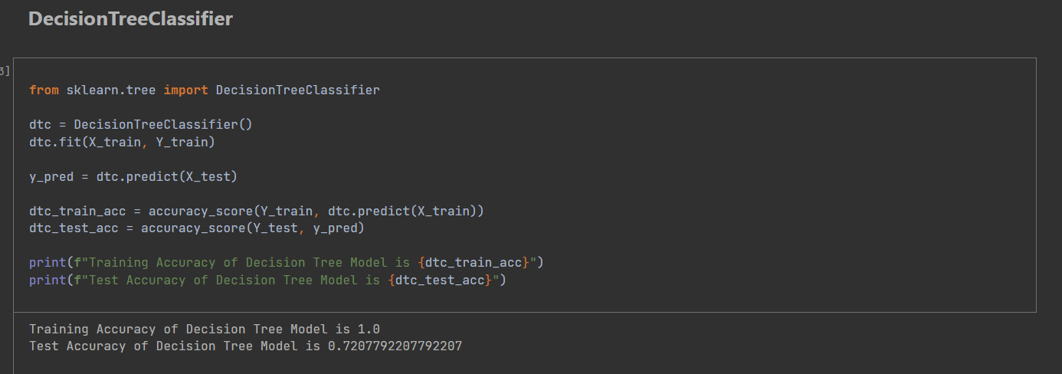
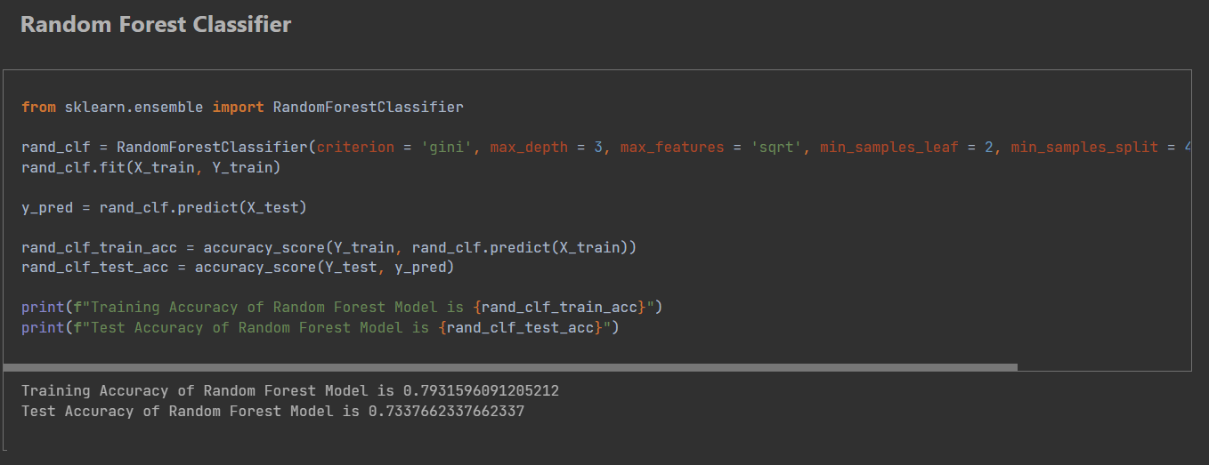
Model Training
We will train different model after the evaluation of model we will select out best model for production.
Logistic Regression
KNN
SVC
Decision Tree
Random Forest Regressor
XgBoost
Gradient Boosting

Slide 19
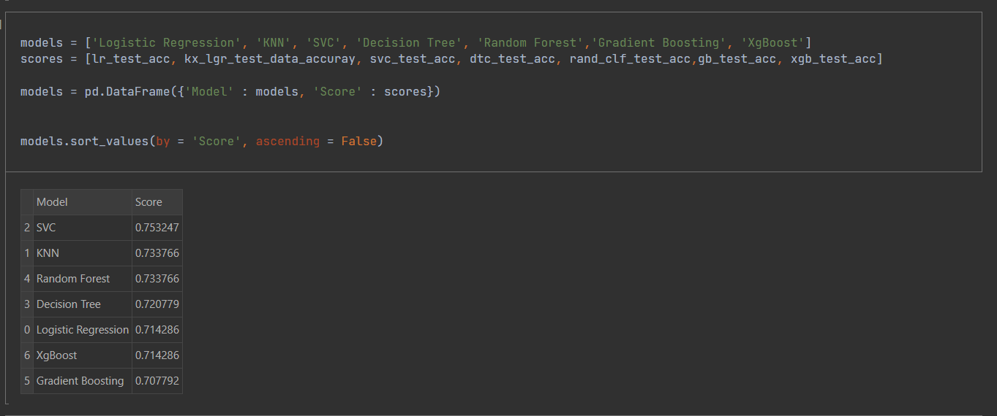
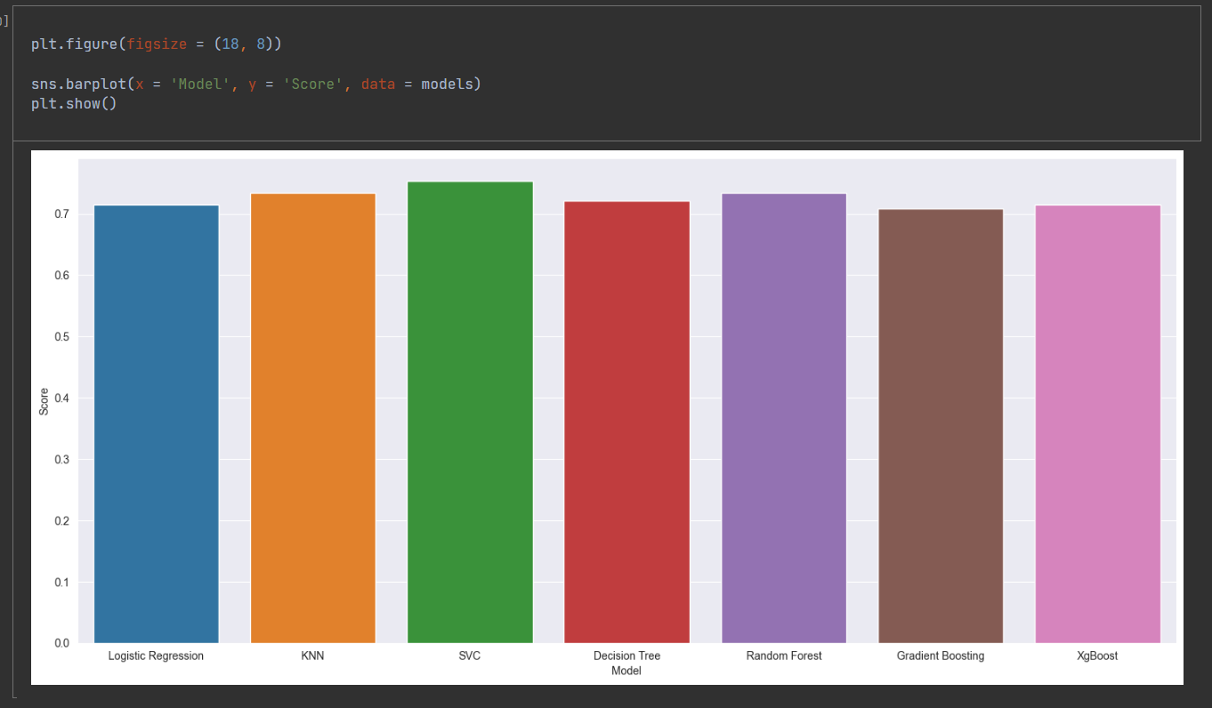
Model Training scores
SVC gives us the best result so we will save this model for production but it overfitted then I select Random Forest

Slide 20
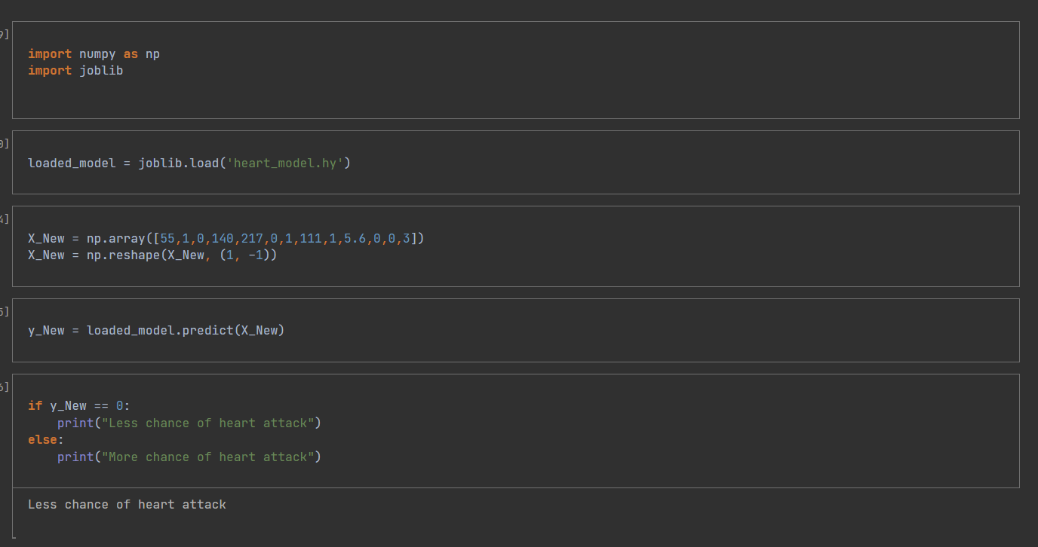
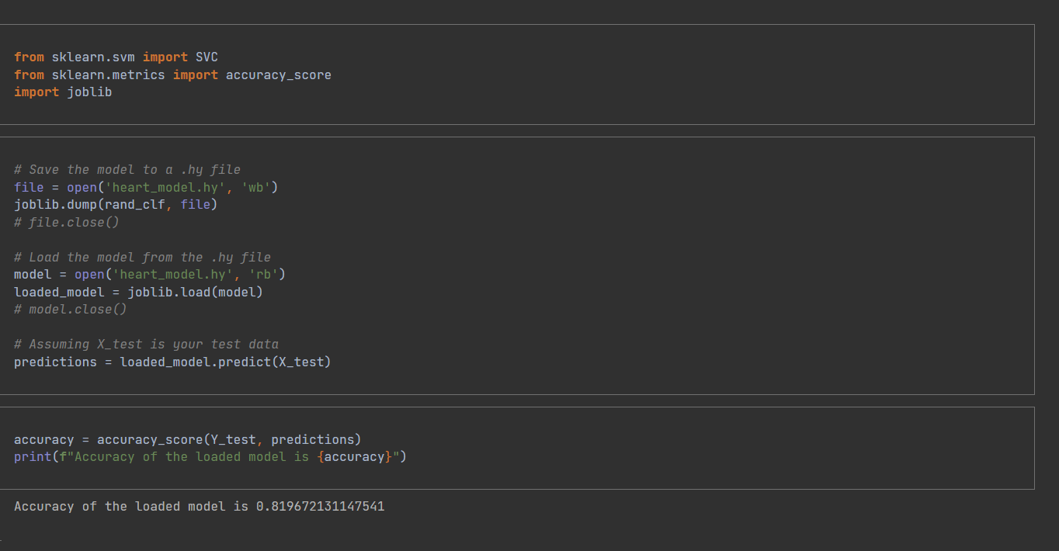
Algorithm selection and test Prediction
So, this will Verify that Our Imported Hy file provides the desired out put for the Analysis & Prediction Dataset for Prediction Purpose

Slide 21
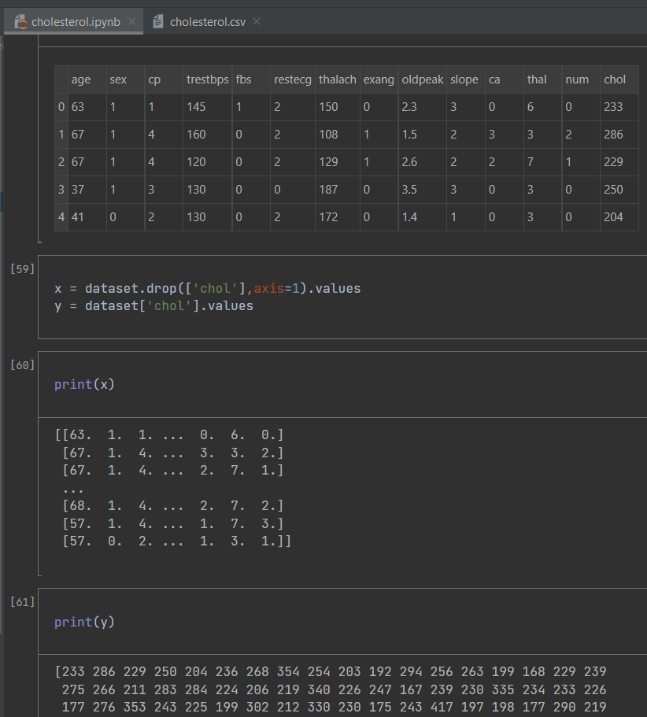
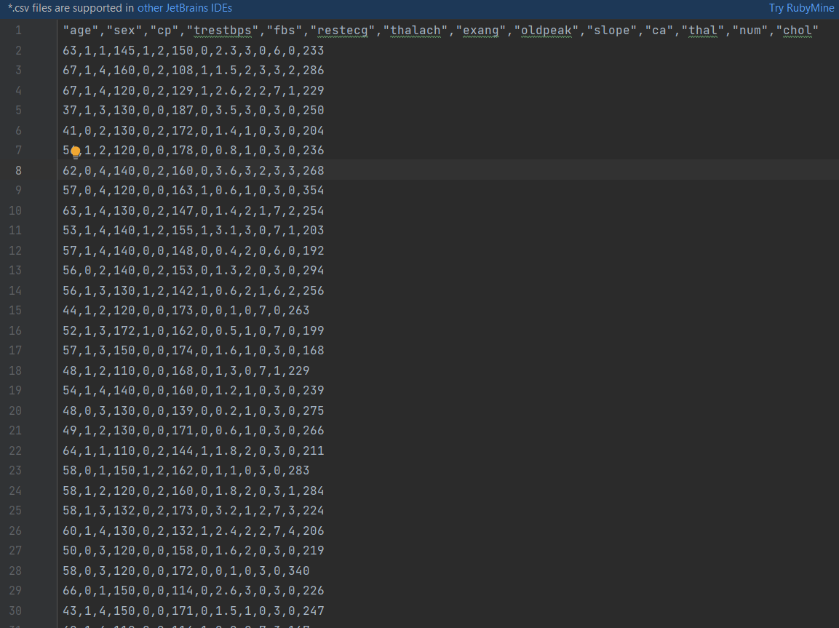
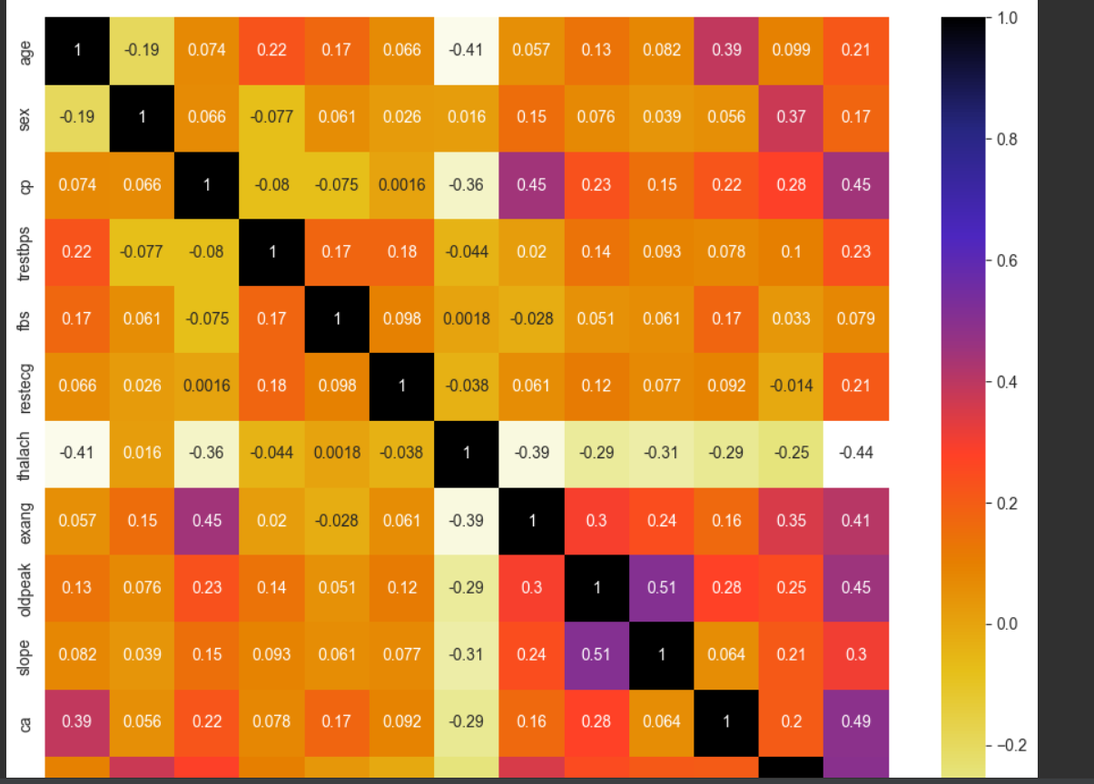
We gathered suitable dataset from the Kaggle website.
Title : Cholesterol Prediction
how affect for metabolic syndrome cholesterol and high blood pressure, that’s why I selected to train this model.
Methodology
Import data CSV file
Model preparation
Y is the dependent variable
Y = chol
X is the independent variable
X = all the other variables except the output (age, sex,…….)

Slide 22
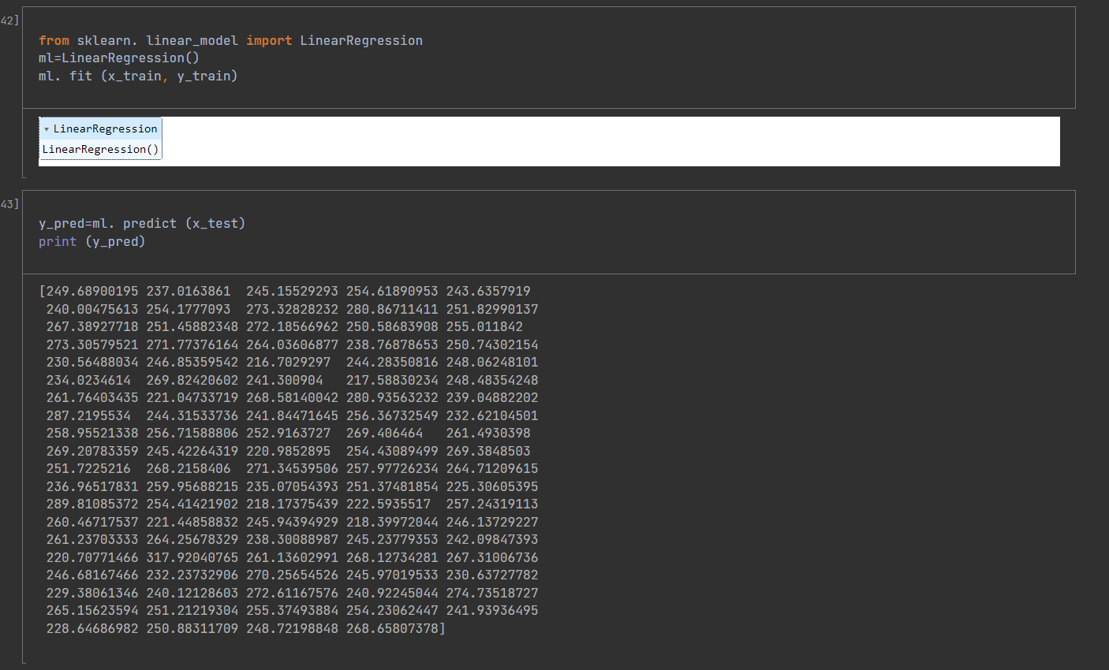
Model Training
We will use the logistic regression algorithm to train the model for production.
Logistic Regression

Slide 23
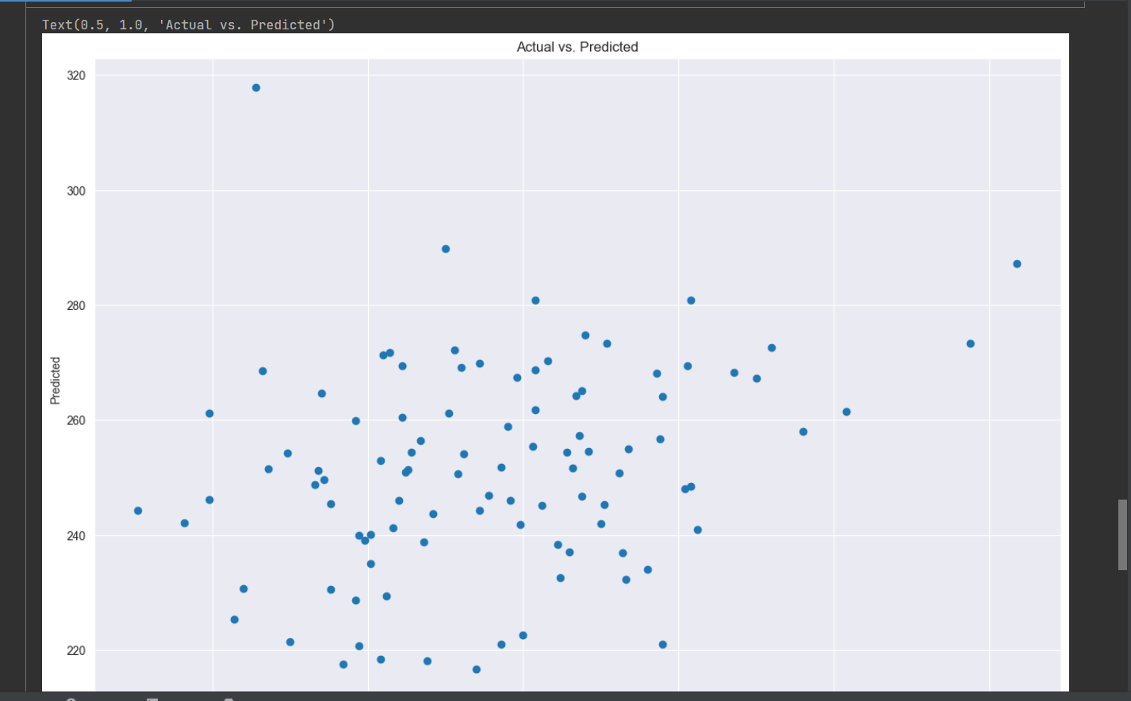
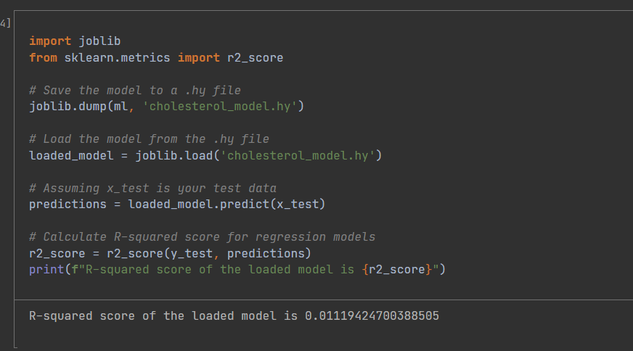
Test Prediction
So, this will Verify that Our Imported Hy file provides the desired out put for the Analysis & Prediction Dataset for Prediction Purpose

Slide 24
Risks factors and Solutions
How to Find the correct data and data are Limited or Unbalanced
we used Kaggle website to find the correct data set but there are so many null values and duplicate values in our data set- we drop all those values.
How to import correct Packages
specially pip3 install --upgrade tensorflow command.
we have to use terminal to import only this packages but other packagers are imported using settings -> python interpreter.
Overfitting
Overfitting occurs when a model learns the training data too well, resulting in poor generalization to new, unseen data.
Model Selection
Choosing the right model architecture or algorithm can be challenging.
Hyperparameter Tuning (process of selecting the optimal configuration of hyperparameters for a machine learning algorithm)
Diabetes-- hyper parameter tuning -> Decision tree

Slide 25
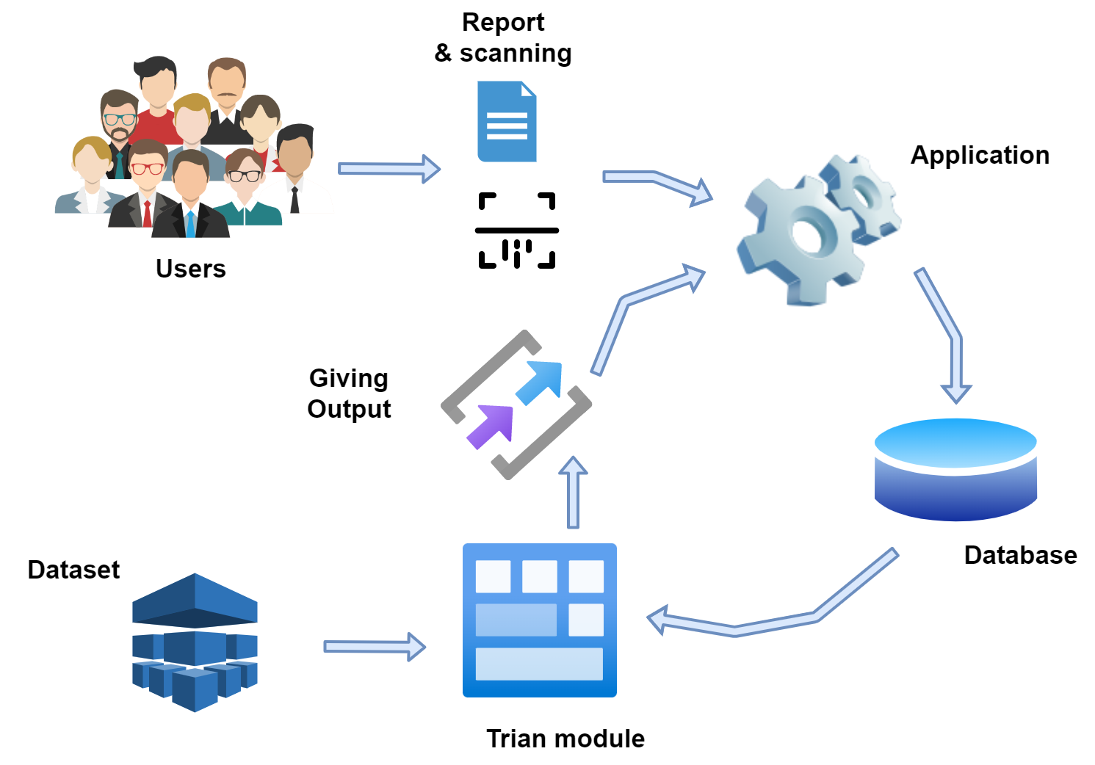
System Overview

Slide 26
Functional requirements | Non Functional requirements
The system must be able to accurately analyze and interpret medical reports from a variety of sources, including electronic health records and laboratory test results. | Compatible to any smart device Processing speed
The system must be able to identify patterns and trends in patient data that can inform personalized treatment recommendations. | Reliability Availability Accuracy
Functional & Non functional requirements

Slide 27



Technologies
Python : PyCharm software to develop Models
Figma : creating UI /UX
Firebase :Our database
GitLab : Opensource Version Control System
Machine learning technology :
Some Model training –
Logistic Regression
KNN
SVC
Decision Tree
Random Forest Regressor
XgBoost
Gradient Boosting

Slide 28
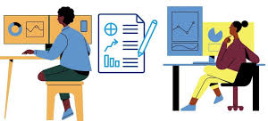
Main Objectives
To track and monitor health metrics in real-time using medical records.
To identify patterns and trends in health metrics that can inform personalized health guidance.

Slide 29
Specific Objectives
Develop algorithms and machine learning techniques to extract relevant health metrics from medical records
Create a database or platform to store and update health metrics in real-time
Identify and track key health metrics such as blood pressure, blood sugar levels, fasting triglyceride levels, cholesterol levels, and steps taken
Analyze health metrics over time to identify patterns and trends that can inform personalized health guidance
Develop a user-friendly interface for patients and healthcare providers to access and interpret health metric data
Evaluate the effectiveness of personalized health guidance based on tracked health metrics in improving health outcomes for patients with metabolic syndrome.

Slide 30
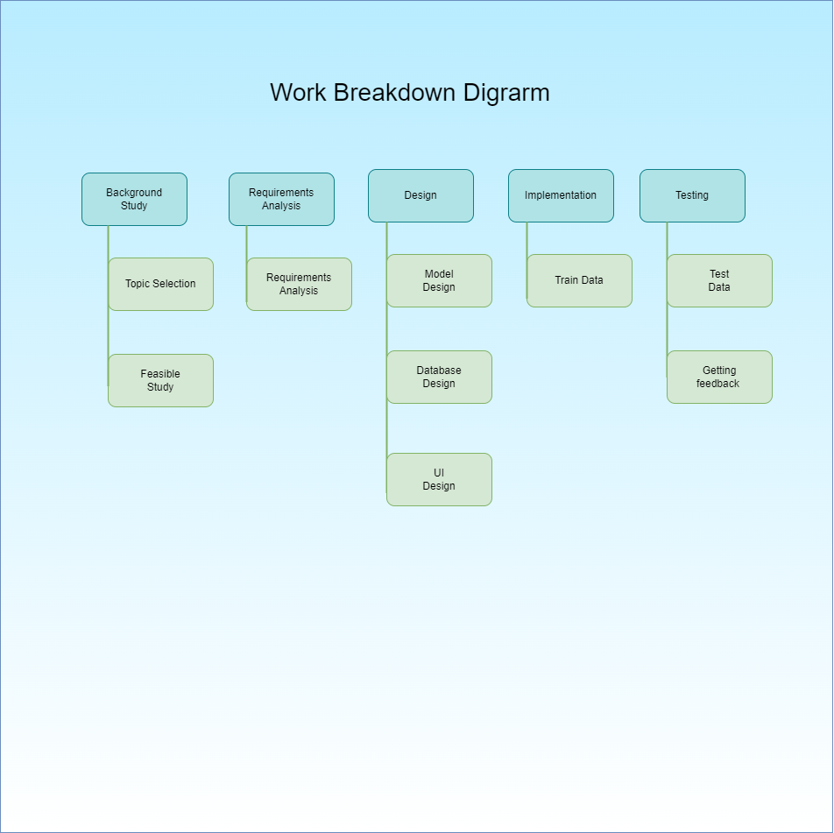
Work break down chart

Slide 31
References
[1] B. Jeffrey, M. Bagala, A. Creighton, T. Leavey, S. Nicholls, C. Wood, J. Longman, J. Barker, and S. Pit, “Mobile phone applications and their use in the self-management of type 2 diabetes mellitus: A qualitative study among app users and non-app users,” Diabetology & Metabolic Syndrome, vol. 11, no. 1, 2019.
[2] D. E. Schoffman, G. Turner-McGrievy, S. J. Jones, and S. Wilcox, “Mobile apps for pediatric obesity prevention and treatment, healthy eating, and physical activity promotion: Just fun and games?,” Translational Behavioral Medicine, vol. 3, no. 3, pp. 320–325, 2013.
[3] S. Zhang, M. Xu, W. Zhang, C. Liu, and S. Chen, “Natural polyphenols in metabolic syndrome: Protective mechanisms and clinical applications,” International Journal of Molecular Sciences, vol. 22, no. 11, p. 6110, 2021.
[4] T. Toro-Ramos, D.-H. Lee, Y. Kim, A. Michaelides, T. J. Oh, K. M. Kim, H. C. Jang, and S. Lim, “Effectiveness of a smartphone application for the management of metabolic syndrome components focusing on weight loss: A preliminary study,” Metabolic Syndrome and Related Disorders, vol. 15, no. 9, pp. 465–473, 2017.

Slide 32

Disanayaka D.M.R.A
IT20264048
BSc (Hons)
in
Information Technology Specializing in Software Engineering

Slide 33



Research Component
Monitoring And Tracking

Slide 34

Background
One of the key components of our personalized mobile patient guidance system for early detection and management of metabolic syndrome is the ability to monitor and track the progress of patients.
With our system, patients can easily upload their medical reports and receive personalized recommendations based on their risk level.
The monitoring and tracking component uses machine learning algorithms to categorize patients based on their current situation and predict their future health outcomes.
With continuous monitoring and regular check-ins, our system ensures that patients are always informed and up-to-date on their health status, empowering them to take control of their health and prevent future complications.

Slide 35


Research problem
Difficulties correctly identifying and monitoring the course of metabolic syndrome in individuals
Insufﬁcient personalized guidance and support for patients managing metabolic syndrome
There is a lack of real-time monitoring and tracking technologies for the management of metabolic syndrome.
Insufficient methods or models for forecasting future health outcomes in metabolic syndrome patients.
Poor patient data and monitoring system integration for optimal illness management

Slide 36
Methodology
System overview Diagram.
Technology Involved
Requirements
WBS

Slide 37
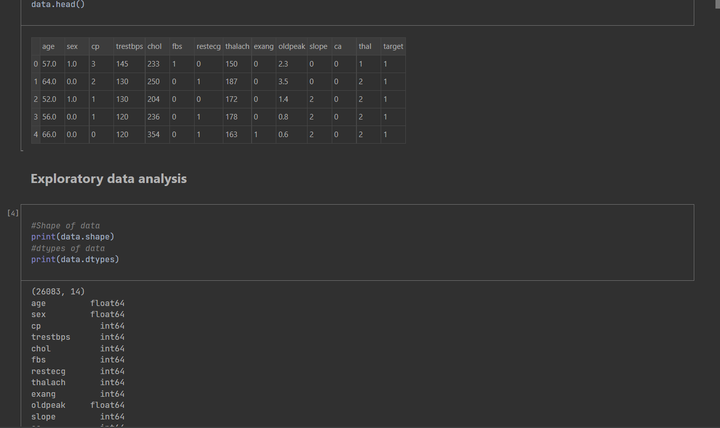
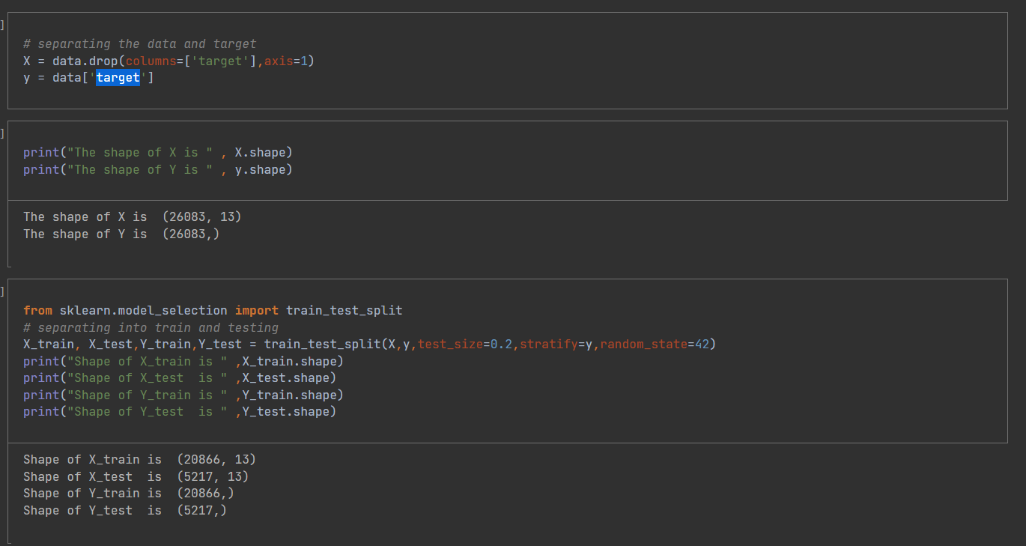
We gathered suitable dataset from the Kaggle website.
Title : High Blood Pressure Prediction
how affect for metabolic syndrome Diabetes, that’s why I selected to train this model.
Status :
0 --> less chance
1 --> more chance
Methodology
Import data CSV file
Model preparation
Y is the dependent variable
Y = target
X is the independent variable
X = all the other variables except the output (age,sex,cp,trestbps,chol,fbs,…)
Exploratory data analysis

Slide 38
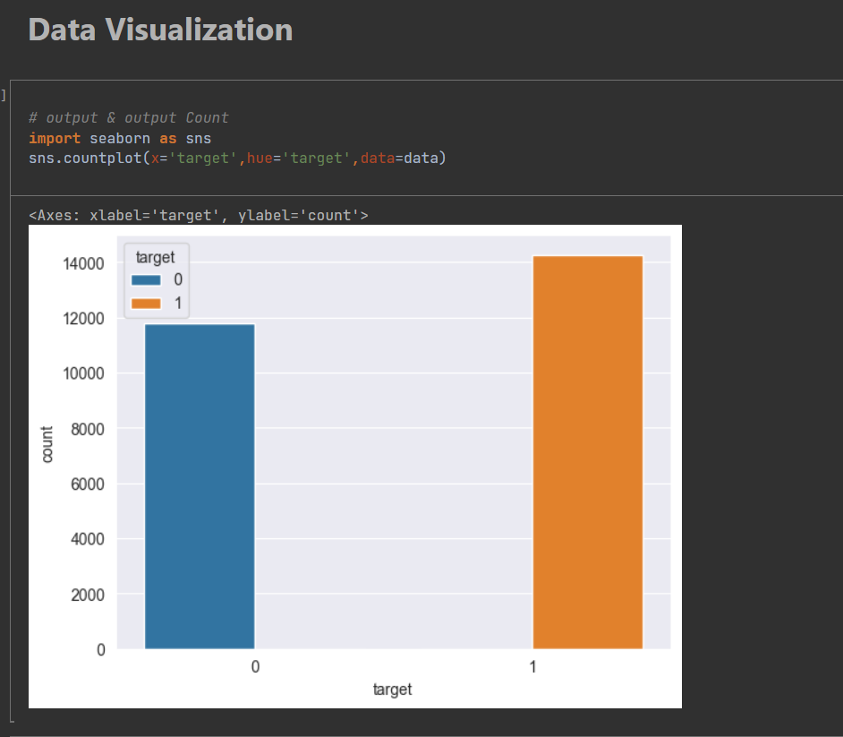
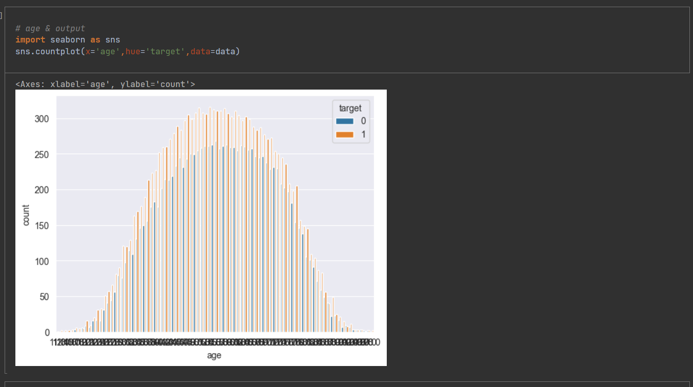
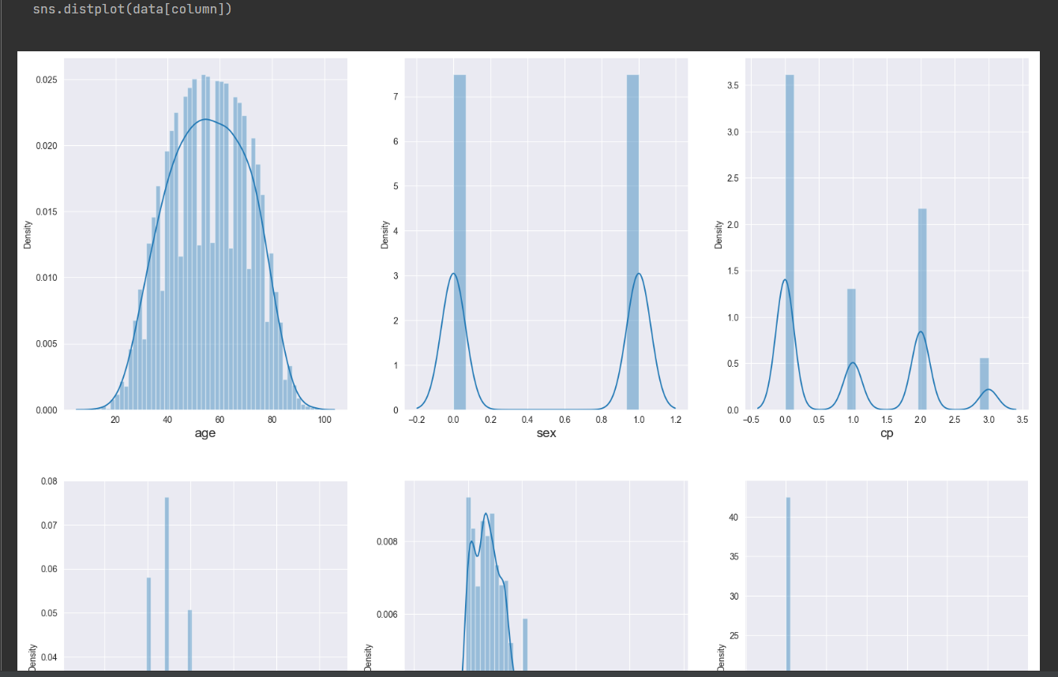
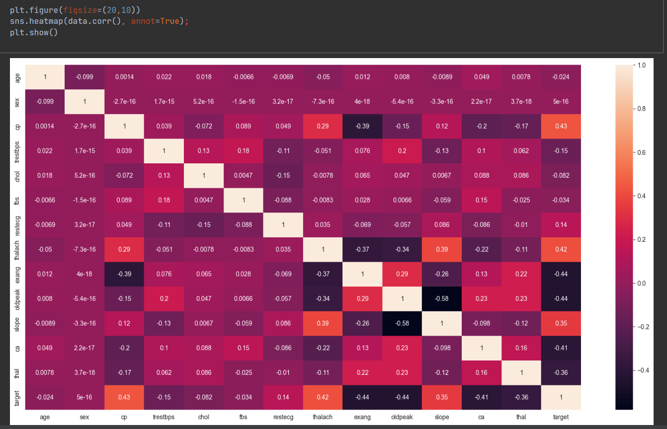
Data visualization part
We can see that the distribution of data is normal ! lets move for the Model preparation.

Slide 39
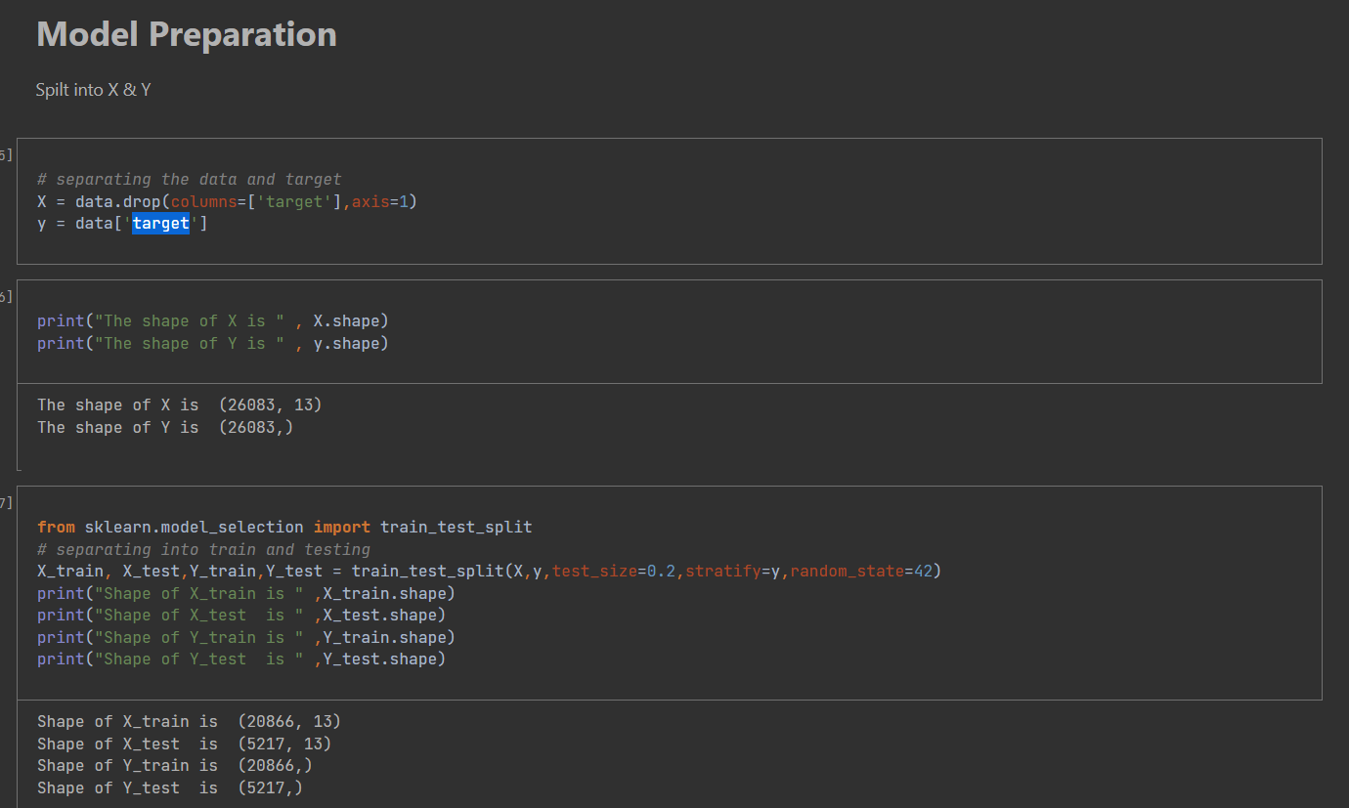
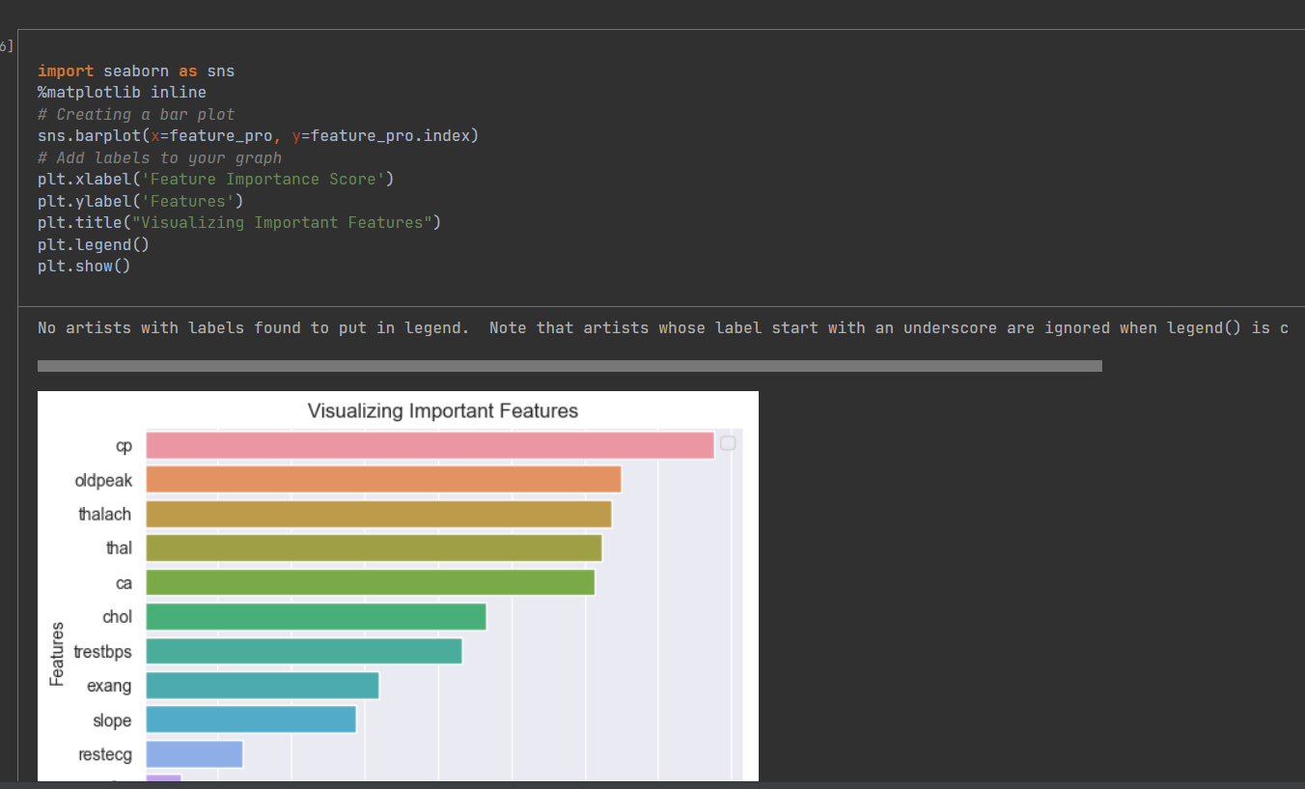
Module preparation
Set X and Y values
Separate data set to test values and train values
Feature Importance's Visualizing

Slide 40
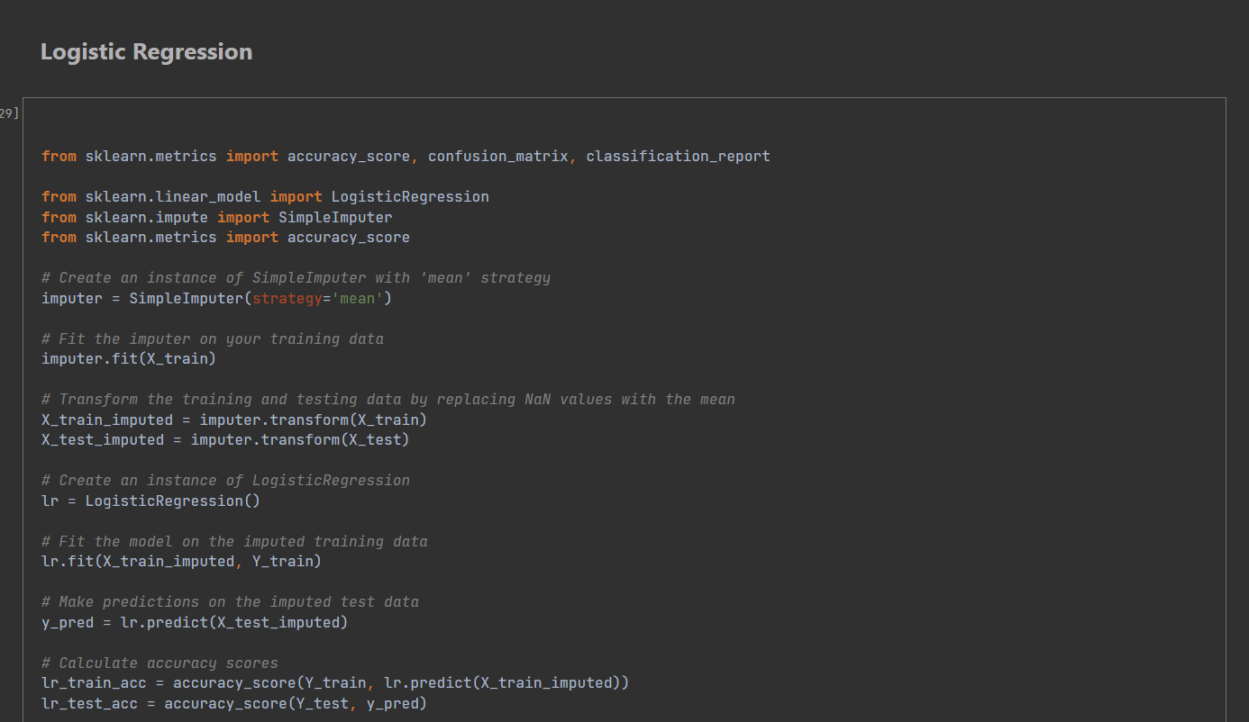
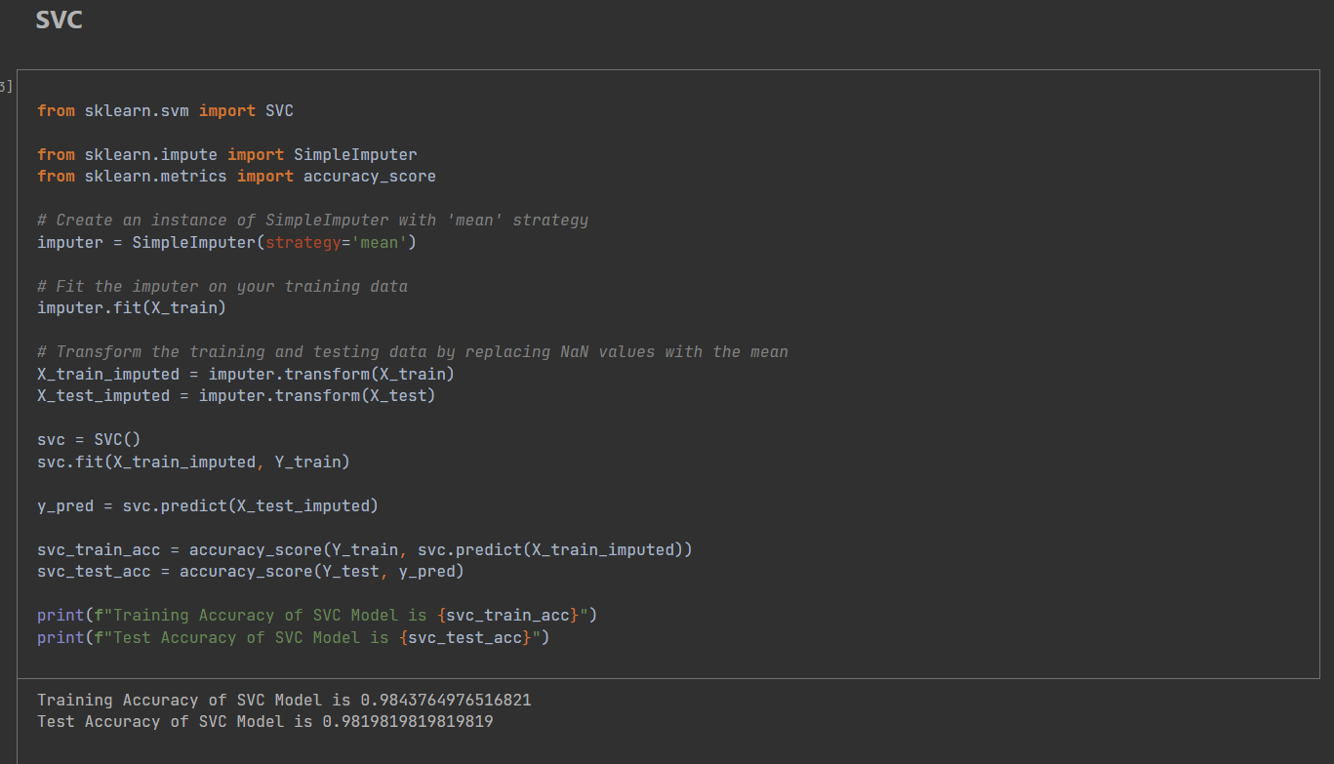
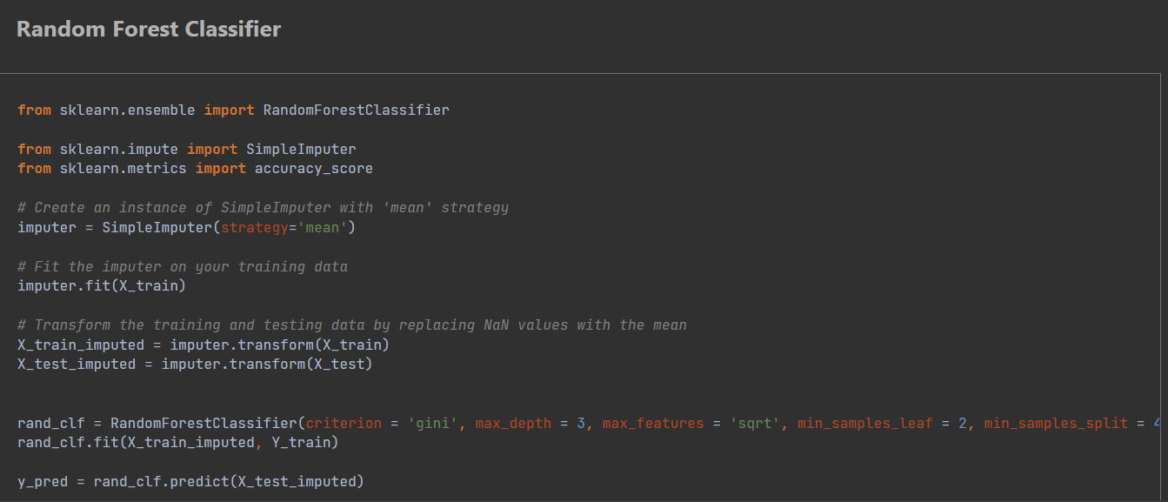
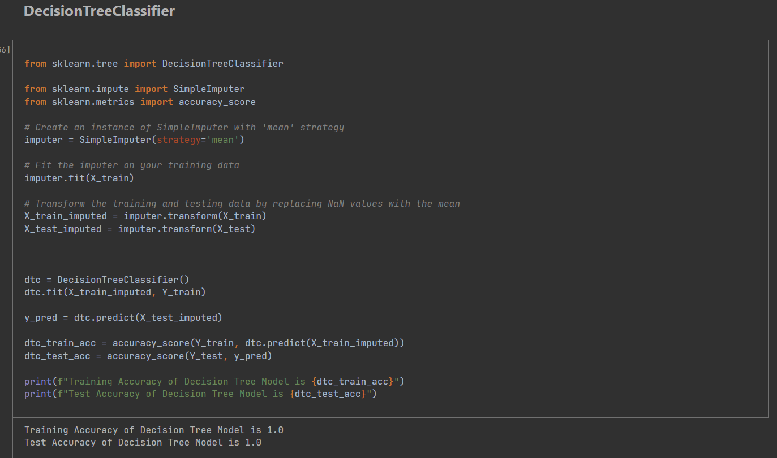
Model Training
We will train different model after the evaluation of model we will select out best model for production.
Logistic Regression
KNN
SVC
Decision Tree
Random Forest Regressor
XgBoost
Gradient Boosting

Slide 41


Model Training scores
SVC gives us the best result so we will save this model for production but it overfitted then I select Random Forest

Slide 42


Algorithm selection and test Prediction
So, this will Verify that Our Imported Hy file provides the desired out put for the Analysis & Prediction Dataset for Prediction Purpose

Slide 43

We gathered suitable dataset from the Kaggle website.
Title : Tryglisaride Prediction
how affect for metabolic syndrome Diabetes, that’s why I selected to train this model.
Status :
0 --> less chance
1 --> more chance
Methodology
Import data CSV file
Model preparation
Y is the dependent variable
Y = TG
X is the independent variable
X = all the other variables except the output (sex,age,chol,BMI,…)
Exploratory data analysis

Slide 44

Model Training
We will use the logistic regression algorithm to train the model for production.
Logistic Regression

Slide 45


Test Prediction
So, this will Verify that Our Imported Hy file provides the desired out put for the Analysis & Prediction Dataset for Prediction Purpose

Slide 46
Risks factors and Solutions
How to Find the correct data and data are Limited or Unbalanced
we used Kaggle website to find the correct data set but there are so many null values and duplicate values in our data set
we drop all those values.
How to import correct Packages
specially pip3 install --upgrade tensorflow command.
we have to use terminal to import only this packages but other packagers are imported using settings -> python interpreter.
Overfitting
Overfitting occurs when a model learns the training data too well, resulting in poor generalization to new, unseen data.
SVC gives us the best result so we will save this model for the production but it overfitted then I selected Random forest.
Model Selection
Choosing the right model architecture or algorithm can be challenging.
Hyperparameter Tuning (process of selecting the optimal configuration of hyperparameters for a machine learning algorithm)
High Blood Pressure-- hyper parameter tuning -> Decision tree
Triglycerides Level -- hyper parameter tuning -> Decision tree

Slide 47

System Overview

Slide 48
Functional requirements | Non Functional requirements
The system must allow healthcare providers to access and review patient data, including monitoring patient progress, setting goals, and adjusting treatment plans as needed | Security
System should track patient report history and update profile according to the progression. | Availability
System should be able to categorize patients according to the medical records and patient's details | Reliability
Functional & Non functional requirements

Slide 49
Technologies
Python : PyCharm software to develop Models
Figma : creating UI /UX
Firebase :Our database
GitLab : Opensource Version Control System
Machine learning technology :
Some Model training –
Logistic Regression
KNN
SVC
Decision Tree
Random Forest Regressor
XgBoost
Gradient Boosting

Slide 50
Main Objectives
Develop a mobile patient guiding system for early detection and treatment of metabolic syndrome through real-time monitoring and tracking of patient data, providing individualized advice and support for healthy lifestyle decisions.

Slide 51
Specific Objectives
Develop a tracking system to monitor how patients complete the recommended tasks and update their profile based on their progress.
Develop a monitoring and tracking system that collects patient report history to inform patients about their current metabolic syndrome status.
Implement an algorithm that categorizes patients according to their metabolic syndrome status and maintain patient profiles based on their category.
Implement a task completion feature where patients can complete the recommended tasks and update their profile accordingly.

Slide 52

Work break down chart

Slide 53
References
[ 1 ] S. J. J. Alian, "A Personalized Recommendation System to Support Diabetes Self-Management for American Indians," IEEE Access, vol. 6, pp. 73041-73051, 2018. Available : https://ieeexplore.ieee.org/abstract/document/8539994
[8] S. V. 1, "Dynamic Physical Activity Recommendation Delivered through a Mobile Fitness App: A Deep Learning Approach," 18 July 2022. Available :Axioms | Free Full-Text | Dynamic Physical Activity Recommendation Delivered through a Mobile Fitness App: A Deep Learning Approach (mdpi.com)
[9] G. Sannino, "A Wellness Mobile Application for Smart Health: Pilot Study Design and Results," 17 March 2017.Available : Sensors | Free Full-Text | A Wellness Mobile Application for Smart Health: Pilot Study Design and Results (mdpi.com)
[10] M. M. Islam, "Development of an Artificial Intelligence–Based Automated Recommendation System for Clinical Laboratory Tests: Retrospective Analysis of the National Health Insurance Database," vol. 8, 18.11.2020. Available : https://medinform.jmir.org/2020/11/e24163
[11] E. Bonara, "The metabolic syndrome and cardiovascular disease," vol. 38, no. 1, pp. 64-80, 08 Jul 2009.Available: https://www.tandfonline.com/doi/full/10.1080/07853890500401234
[12] R. Prasad, "Metabolic syndrome and chronic kidney disease

Slide 54

Peiris B.M.G
IT20147396
BSc (Hons)
in
Information Technology Specializing in Information Technology

Slide 55





What is my Research Component?
Giving Health Recommendations And suggestions based on Metabolic Syndromes

Slide 56



Why I selected this component?
1. Inaccurate diagnoses - There may be having some shortcoming in the hands of any doctors to the patients but , AI based health system never gives wrong treatment to the patient.
2. Not having personalized health recommendation – Every individuals have personalized health requirements like health histories, lifestyles so not having personalized health recommendation system will be not effective.
3. Wasting lots of time - Wasting lots of time to meet medical professionals and get advices and treatments .
4. Expensive treatments -Patients have to face unnecessary expensive treatments and test due to not having AI based health recommendation system.
5. Services are limited -Health services are limited in some areas.

Slide 57





How I do it?
1] Patient input their details
2] Stored them in DB.
3] System will display status of the highest risky disease and system also shows whether the person has metabolic syndrome or not.
4] Then calculate weight of above highest risky disease .
5]display the weight percentage status of above disease.
6]Using this weight system calculate if weight is low or high or medium.
7]Display low status or high status or medium status to the patient.
8] Finally, system will generate health diet plans and exercise plans.

Slide 58

Entire System of the Expected output (sample UI)
faculty of computing / IT20147396 P e i r i s B .M . G

Slide 59

One side flow of the Expected output (sample UI)

Slide 60
What is the Methodology ?
Category | Age range | Scalability | Recommendation
Low HDL and high LDL levels | Less than 10 years old, show some status 10-15 years 16-35 years 36-50 years More than 50 years | Low Middle high | Food recommendation Exercise recommendations
High level of Triglycerides level | 10-15 years 16-35 years 36-50 years More than 50 years | Low Middle high | Food recommendation Exercise recommendations
Abnormal obesity | 10-15 years 16-35 years 36-50 years More than 50 years | Low Middle high | Food recommendation Exercise recommendations
High blood pressure | 10-15 years 16-35 years 36-50 years More than 50 years | Low Middle high | Food recommendation Exercise recommendations
High plasma glucose level | 10-15 years 16-35 years 36-50 years More than 50 years | Low Middle high | Food recommendation Exercise recommendations
In age range:
If the person Less than 10 years old,
system displays this message!
“If the person Less than 10 years old,
you must get the medical advices and meet your doctor”
faculty of computing / IT20147396 P e i r i s B .M . G

Slide 61

What is the Background?
There are five main factors in Metabolic syndromes
Abdominal obesity
High triglycerides
Cholesterol level
high blood pressure
High plasma glucose
If there are 3 of those 5 reasons, we can call that person has Metabolic Syndromes.

Slide 62
What are the Research Gap & Novelties?
 | Previous | Our system
Used technologies and predicting disease. | Only using Deep learning or Machine learning [8],[11],[12] and electronic health records to diagnose disease [10]. | Using Machine learning ,Deep Learning and Artificial Intelligence, tacking technologies and goal setting tools.
Scalability range | previous mobile apps give health recommendations based only one disease[1],[11],[12]. | My system gives health recommendations based 5 diseases including Low HDL and high LDL levels(cholesterol level) Abdominal obesity elevated triglycerides level high blood pressure Elevated plasma glucose level.

Slide 63
 | Previous | Our system
Predicting the weight of the disease | Not used proper predicting method[12]. | My system Gives health recommendations and suggestions based on the risk Weight of the prediction. Found five accurate 5 fomulas with the special doctors to predict the weight of the disease
ABDOMINAL OBESITY
Percentage Rate = ((Age Value / Age Threshold) * Age Weight) + ((Weight Value >= Weight Threshold) * Weight Weight) + ((Height Value >= Height Threshold) * Height Weight)
CHOLESTOROL LEVEL
Percentage Rate = ((Age Value / Age Threshold) * Age Weight) + ((thalach Value >= thalach Threshold) * thalach Weight) + fbs Value
HIGH BLOOD PRESSURE
Percentage Rate = ((Age Value / Age Threshold) * Age Weight) + ((thalach Value >= thalach Threshold) * thalach Weight) + fbs Value
HIGH BLOOD SUGAR
Percentage Rate = ((Age Value / Age Threshold) * Age Weight) + ((Glucose Value >= Glucose Threshold) * Glucose Value)
TRYGLISARIDE LEVE
Percentage Rate = ((Age Value / Age Threshold) * 100) + ((BMI Value / BMI Threshold) * 100)

Slide 64
Here this is the Low range Meal plan of Abdominal obesity person & age range is 10-16 years
I can provide you with some general recommendations for a dietary plan for a 10-15-year-old person with low-level abdominal obesity. However, please note that it is always best to consult with a healthcare professional or a registered dietitian for personalized advice. Additionally, keep in mind that calorie intake can vary depending on factors such as age, gender, activity level, and specific dietary needs. Here's a sample meal plan:
Breakfast:
- Scrambled eggs (90-150 calories per 100g) with vegetables like spinach and bell peppers.
- Whole grain toast (250-300 calories per 100g) with a thin spread of avocado.
- A serving of mixed fruits like berries or a small apple (approximately 50-70 calories per 100g).
Lunch:
- Grilled chicken breast (165-195 calories per 100g) with a side of steamed vegetables such as broccoli and carrots.
- Quinoa (120-140 calories per 100g) or brown rice (110-120 calories per 100g) as a whole grain option.
- A small mixed green salad with a light vinaigrette dressing (varies depending on ingredients).
Snack options:
- Greek yogurt (80-130 calories per 100g) with a handful of mixed nuts (e.g., almonds, walnuts).
- Baby carrots with hummus dip ( 50-60 calories per 100g).
- Sliced cucumber with a low-fat yogurt dip (calories vary based on dip used).
Dinner:
- Baked salmon fillet (150-200 calories per 100g) seasoned with herbs and lemon.
- Steamed asparagus or green beans as a side (20-30 calories per 100g).
Sweet potato mash (90-110 calories per 100g) as a healthier alternative to regular mashed potatoes.
Remember to focus on portion control, prioritize whole foods, and limit added sugars and processed foods. It's important to encourage regular physical activity and drink plenty of water throughout the day.

Slide 65
Here this is the Low range Exercise plan of Abdominal obesity person & age range is 10-16 years
10 to 15 Years Old:
Low Abdominal Obesity:
- Monday: Seated Marches, Seated Leg Extensions, Standing Side Leg Lifts
- Wednesday: Standing Wall Push-Ups, Chair Squats, Seated Torso Twists
- Friday: Seated Bicycle Crunches, Modified Plank on Chair, Seated Shoulder Circles
Medium Abdominal Obesity:
- Monday: Standing Wall Push-Ups, Chair Squats, Seated Marches
- Wednesday: Modified Plank on Chair, Seated Bicycle Crunches, Seated Leg Extensions
- Friday: Standing Side Leg Lifts, Seated Torso Twists, Seated Shoulder Circles
High Abdominal Obesity:
- Monday: Seated Marches, Seated Leg Extensions, Seated Torso Twists
- Wednesday: Seated Bicycle Crunches, Chair Squats, Modified Plank on Chair
- Friday: Seated Shoulder Circles, Standing Wall Push-Ups, Standing Side Leg Lifts

Slide 66
BACKEND LOGIC
ABDOMINAL OBESITY
Percentage Rate = ((Age Value / Age Threshold) * Age Weight) + ((Weight Value >= Weight Threshold) * Weight Weight) + ((Height Value >= Height Threshold) * Height Weight)
Height Weight = 55cm [patient input data]
Height Threshold = 70cm
Height Value = 0
Age: 30 [patient input data]
Weight: 55kg [patient input data]
Height: 55cm [patient input data]
Age:
- 10-15 years: Threshold = 10, Value = 1
- 16-35 years: Threshold = 16, Value = 2
- 36-50 years: Threshold = 36, Value = 3
- More than 50 years: Threshold = 50, Value = 4
Age Value = 2
Age Threshold = 16
Age Weight = 30 [patient input data]
(If the Height that entered by the patient is less than 70cm, the Height value is 0. If the Height that entered by the patient is greater than 70cm, the Height value is 1)
Weight Weight = 55kg [patient input data]
Weight Threshold = 81kg
Weight Value = 0
(If the weight that entered by the patient is less than 81kg, the weight value is 0. If the weight that entered by the patient is more than 81kg, the weight value is 1)

Slide 67
Percentage Rate = ((Age Value / Age Threshold) * Age Weight) + ((Weight Value >= Weight Threshold) * Weight Weight) + ((Height Value >= Height Threshold) * Height Weight)
Percentage Rate = ((2 / 16) * 30) + ((0 >= 81)*55) + ((0 >=70)*55)
= (0.125 * 30) + 0 + 0
= 3.75 + 0 + 0
= 3.75%
low than (-2.5) = give low health recommendations
(-2.5) to (4.0) = give medium health recommendations
more than (4.0) =give high health recommendations
there fore 3.75% is medium health recommendations.

Slide 68
CHOLESTEROL LEVEL
Percentage Rate = ((Age Value / Age Threshold) * Age Weight) + ((thalach Value >= thalach Threshold) * thalach Weight) + fbs Value
Age: 60 [patient input data]
Maximum Heart Rate (thalach): 170 [patient input data]
Fasting Blood Sugar (fbs): 1 [patient input data]
Age:
10-15 years: Threshold = 10, Value = 1
16-35 years: Threshold = 16, Value = 2
36-50 years: Threshold = 36, Value = 3
More than 50 years: Threshold = 50, Value = 4
Age Value = 4
Age Threshold(measuring stick) = 50
Age Weight = 60 [patient input data]
thalach value=0
thalach Threshold(measuring stick) = 180
thalach Weight = 170 [[patient input data]
If the thalach value entered by the patient is less than 180, the thalach value is 0. If the thalach value entered by the patient is more than 180, the thalach value is 1.
fbs Value = 1 [patient input data]

Slide 69
Percentage Rate = ((Age Value / Age Threshold) * Age Weight) + ((thalach Value >= thalach Threshold) * thalach Weight) + fbs Value
Percentage Rate = ((4 / 50) * 60) + ((0 >= 180) * 170) + 1
= (0.08 * 60) + (0 * 170) + 1
= 4.8 + 0 + 1
= 5.8%
low than 15 = give low health recommendations
15-25 = give medium health recommendations
more than 25 =give high health recommendations
there fore 5.8% is low health recommendations.

Slide 70
HIGH BLOOD PRESSURE
Percentage Rate = ((Age Value / Age Threshold) * Age Weight) + ((thalach Value >= thalach Threshold) * thalach Weight) + fbs Value
Age: 60 [patient input data]
Maximum Heart Rate (thalach): 170 [patient input data]
Fasting Blood Sugar (fbs): 1 [patient input data]
Age:
10-15 years: Threshold = 10, Value = 1
16-35 years: Threshold = 16, Value = 2
36-50 years: Threshold = 36, Value = 3
More than 50 years: Threshold = 50, Value = 4
Age Value = 4
Age Threshold(measuring stick) = 50
Age Weight = 60 [patient input data]
thalach value=0
thalach Threshold(measuring stick) = 180
thalach Weight = 170 [patient input data]
If the thalach value entered by the patient is less than 180, the thalach value is 0. If the thalach value entered by the patient is more than 180, the thalach value is 1.
fbs Value = 1 [patient input data]

Slide 71
Percentage Rate = ((Age Value / Age Threshold) * Age Weight) + ((thalach Value >= thalach Threshold) * thalach Weight) + fbs Value
Percentage Rate = ((4 / 50) * 60) + ((0 >= 180) * 170) + 1
= (0.08 * 60) + (0 * 170) + 1
= 4.8 + 0 + 1
= 5.8%
low than 15 = give low health recommendations
15-25 = give medium health recommendations
more than 25 =give high health recommendations
there fore 5.8% is low health recommendations.

Slide 72
HIGH BLOOD SUGAR
Percentage Rate = ((Age Value / Age Threshold) * Age Weight) + ((Glucose Value >= Glucose Threshold) * Glucose Value)
Age:40 [patient input data]
Glucose level:170 [patient input data]
Age:
10-15 years: Threshold = 10, Value = 1
16-35 years: Threshold = 16, Value = 2
36-50 years: Threshold = 36, Value = 3
More than 50 years: Threshold = 50, Value = 4
Age Value = 3
Age Threshold = 36
Age Weight = 40 [patient input data]
Glucose Value = 1 ( glucose level is equal or above the 100)
Glucose Threshold = 100

Slide 73
Percentage Rate = ((Age Value / Age Threshold) * Age Weight) + ((Glucose Value >= Glucose Threshold) * Glucose Value)
Percentage Rate = ((3 / 36) * 40) + ((1 >= 100) * 1)
= (0.0833 * 40) + (0 * 1)
= 3.33 + 0
= 3.33%
low than 15 = give low health recommendations
15-25 = give medium health recommendations
more than 25 =give high health recommendations
there fore 3.33% is low health recommendations.

Slide 74
TRYGLISARIDE LEVE
Percentage Rate = ((Age Value / Age Threshold) * 100) + ((BMI Value / BMI Threshold) * 100)
Age: 40 [patient input data]
BMI: 27.2 [patient input data]
Age:
10-15 years: Threshold = 10, Value = 1
16-35 years: Threshold = 16, Value = 2
36-50 years: Threshold = 36, Value = 3
More than 50 years: Threshold = 50, Value = 4
Age: 40 years ( 36-50 years)
Age Value = 3
Age Threshold = 36
BMI:
0-18.5: Threshold = 18.5, Value = 1
18.5-24.9: Threshold = 24.9, Value = 2
24.9-29.9: Threshold = 29.9, Value = 3
more than 30: Threshold = 30, Value = 4
BMI Value = 3
BMI Threshold = 29.9
We do not take the BMI that the patient inputs into the equation when searching for the triglyceride equation. We use that value to find the BMI value and the BMI threshold.
When looking for the triglyceride equation, we do not take the age that the patient inputs into the equation. We use that value to find the age value and the age threshold.

Slide 75
Percentage Rate = ((Age Value / Age Threshold) * 100) + ((BMI Value / BMI Threshold) * 100)
In this equation, 100 is a constant.
Percentage Rate = ((3 / 36) * 100) + ((3 / 29.9) * 100)
= (0.0833 * 100) + (0.1003 * 100)
= 8.33 + 10.03
= 18.36%
low than 15 = give low health recommendations
15-25 = give medium health recommendations
more than 25 =give high health recommendations
there fore 18.36% is Medium health recommendations.

Slide 76


Final output →

Slide 77




Slide 78




Slide 79



Slide 80



Slide 81




Slide 82

System Overview

Slide 83

We gathered suitable dataset from the Kaggle website.
Title : Heart Attack Prediction
This heart attacks happens as a side effect of cholesterol and high blood pressure, that’s why I selected to train this model.
Heart Attack Status :
0 --> less chance of heart attack
1 --> more chance of heart attack
Methodology
Import data CSV file
Check null values
If there are null values ,we must drop those null values
In here there are no any null values
3. Check duplicates
It has 1 duplicate value.so I drop this value

Slide 84



Model training
We will train the different model after the evaluation of the model we will select out best model for the production
Logistic Regression
ii.KNN
iii.SVC

Slide 85



Decision tree
Random forest Regressor

Slide 86


Random forest Regressor
Gradient Boosting
XgBoost

Slide 87
Risks factors and Solutions
How to Find the correct data and data are Limited or Unbalanced
we used Kaggle website to find the correct data set but there are so many null values and duplicate values in our data set
we drop all those values.
How to import correct Packages
specially pip3 install --upgrade tensorflow command.
we have to use terminal to import only this packages but other packagers are imported using settings -> python interpreter.
Overfitting
Overfitting occurs when a model learns the training data too well, resulting in poor generalization to new, unseen data.
SVC gives us the best result so we will save this model for the production but it overfitted then I selected Random forest.
Model Selection
Choosing the right model architecture or algorithm can be challenging.
Hyperparameter Tuning (process of selecting the optimal configuration of hyperparameters for a machine learning algorithm)
Heart Attack -- hyper parameter tuning -> Decision tree

Slide 88
Functional requirements | Non Functional requirements
Communications and Reaction | Accuracy
Customized Food Advice | Usability
Suggestions for strong Exercise | performance
Medication Management Advice | Efficiency
Customer Interaction | Compatibility
Predicted Analyses | Reliability
Functional & Non functional requirements

Slide 89
Technologies
Python : PyCharm software to develop Models
Figma : creating UI /UX
Firebase :Our database
GitLab : Opensource Version Control System
GitHub: Opensource Version Control System
Machine learning technology :
Some Model training –
Logistic Regression
KNN
SVC
Decision Tree
Random Forest Regressor
XgBoost
Gradient Boosting

Slide 90

Main Objectives
Giving personalized health recommendation system based on metabolic syndromes Ex: solving many health problems of people in remote areas in Sri Lanka based on metabolic syndromes. Specially, Monaragala, Puttalam, Batticaloa.

Slide 91

Specific Objectives
can assist people in identifying their metabolic syndrome risk factors
Suggestions and recommendations can offer specific information on dietary and exercise changes, medication use, and other lifestyle adjustments.
Managing metabolic syndrome correctly can lower the risk of contracting serious illnesses like type 2 diabetes, heart disease, and stroke.
Using goal-setting tools and tracking technologies, offer individualized advice on exercise and diet.

Slide 92
Work break down chart

Slide 93
References
[8] S. V. 1, "Dynamic Physical Activity Recommendation Delivered through a Mobile Fitness App: A Deep Learning Approach," 18 July 2022. Available :Axioms | Free Full-Text | Dynamic Physical Activity Recommendation Delivered through a Mobile Fitness App: A Deep Learning Approach (mdpi.com)
[9] G. Sannino, "A Wellness Mobile Application for Smart Health: Pilot Study Design and Results," 17 March 2017.Available : Sensors | Free Full-Text | A Wellness Mobile Application for Smart Health: Pilot Study Design and Results (mdpi.com)
[10] M. M. Islam, "Development of an Artificial Intelligence–Based Automated Recommendation System for Clinical Laboratory Tests: Retrospective Analysis of the National Health Insurance Database," vol. 8, 18.11.2020. Available : https://medinform.jmir.org/2020/11/e24163
[11] E. Bonara, "The metabolic syndrome and cardiovascular disease," vol. 38, no. 1, pp. 64-80, 08 Jul 2009.Available: https://www.tandfonline.com/doi/full/10.1080/07853890500401234
[12] R. Prasad, "Metabolic syndrome and chronic kidney disease: Current status and future directions," 2014 Nov 6.Available : https://www.ncbi.nlm.nih.gov/pmc/articles/PMC4220353/

Slide 94

Herath H.M.T.P
IT20276850
BSc (Hons)
in
Information Technology Specializing in Software Engineering

Slide 95



Research Component
Customize Health Recommendations and Suggestions.

Slide 96

Background
Personalized plans are key for managing metabolic syndrome and improving health.
Health profile assessment is essential for developing plans.
Tailored plans manage symptoms and achieve goals.
Diet and fitness apps should invest in personalized plans and gather relevant data.
Customized plans improve adherence and disease management.

Slide 97

Research problem
Lack of personalized plans for metabolic syndrome leads to poor outcomes.
Diet/fitness apps don't gather enough relevant data for tailored plans.
Generic plans may result in lower adherence.
Personalized plans can manage symptoms and achieve goal.

Slide 98

Methodology
System Overview Diagram
Technology Involved
Project Requirements
Work Breakdown Diagram

Slide 99

We gathered suitable dataset from the Kaggle website.
Title : BMI Level Prediction
BMI Level Status :
0 - Extremely Weak
1 - Weak
2 - Normal
3 - Overweight
4 - Obesity
5 - Extreme Obesity

Slide 100

Methodology
Import data CSV file
Check null values
If there are null values ,we must drop those null values
In here there are no any null values
3. Check duplicates
It has 11 duplicate values.so I drop them
4. Transformation part
5. Data visualization part → → → → → → → → → → → → → → → →
According to those data visualizations we can see the distribution of data is normal.

Slide 101

Let’s move for the Model preparation
Find the correlation in data set
Model preparation
Y is the dependent variable
Y = output
X is the independent variable
X = all the other variables except the output (Gender, Height, Weight)

Slide 102


Model training
We will train the different model after the evaluation of the model we will select out best model for the production
1.Logistic Regression
2.SVC

Slide 103


3.DecisionTree Classifier
4.KNN

Slide 104


5.XGB Classifier
6.Random Forest Classifier

Slide 105


Get all the test score of the above models.
Using the bar chart get the best solution.
Our accuracy score is 0.8367346938775511.hy file provides the desired output for the BMI dataset for prediction purpose.
SVC gives us the best result so we will save this model for the production but it overfitted then I selected Logistic Regression.
Create a pickle folder for Logistic Regression.

Slide 106
Risks factors and Solutions
How to Find the correct data and data are Limited or Unbalanced
we used Kaggle website to find the correct data set but there are so many null values and duplicate values in our data set
we drop all those values.
How to import correct Packages
specially pip3 install --upgrade tensorflow command.
we have to use terminal to import only this packages, but other packagers are imported using settings -> python interpreter.
Overfitting
Overfitting occurs when a model learns the training data too well, resulting in poor generalization to new, unseen data.
SVC gives us the best result but it overfitted.
Model Selection
Choosing the right model architecture or algorithm can be challenging.
BMI-- -> logistic regression

Slide 107

System Overview

Slide 108
Functional requirements | Non Functional requirements
System should be displayed personalized dietary and fitness plan | Security Processing speed Reliability
System should be displayed personalized dietary and fitness plan | Availability Compatible to any smart device
Functional & Non functional requirements

Slide 109
Technologies
Python : PyCharm software to develop Models
Figma : creating UI /UX
Firebase :Our database
GitLab : Opensource Version Control System
Machine learning technology :
Some Model training –
Logistic Regression
KNN
SVC
Decision Tree
Random Forest Regressor
XgBoost
Gradient Boosting

Slide 110

Main Objectives
To develop and implement a personalized dietary and fitness plan tailored to the health profile of individuals with metabolic syndrome in order to improve their health outcomes.

Slide 111

Specific Objectives
Assess the individual's health profile.
Analyse data for specific needs and goals.
Develop a personalized dietary plan.
Create a customized fitness plan.
Provide ongoing support and monitoring.
Evaluate and adjust the plan for optimization.

Slide 112
Work break down chart

Slide 113
References
[1]C. Wing and H. Yang, “FitYou,” Proceedings of the 37th international ACM SIGIR conference on Research & development in information retrieval, 2014.
[2]G. Agapito, B. Calabrese, P. H. Guzzi, M. Cannataro, M. Simeoni, I. Care, T. Lamprinoudi, G. Fuiano, and A. Pujia, “Dietos: A recommender system for adaptive diet monitoring and personalized food suggestion,” 2016 IEEE 12th International Conference on Wireless and Mobile Computing, Networking and Communications (WiMob), 2016.
[3]Mo Zhou“Personalizing Mobile Fitness Apps using Reinforcement Learning,” CEUR Workshop Proc. 2018 Mar 7

Slide 114

Commercialization We will introduce Personalized smartphone application based on Metabolic Syndrome. According in to my function I will introduced automated health guidance and recommendations system to our project. After the successful completion of our project, we hope to popular this mobile app among the people living in remote areas of Sri Lanka. With the corona epidemic, most people in Sri Lanka are using smartphones, so using this app can solve many health problems of people in remote areas based on metabolic syndromes. Specially, Monaragala, Puttalam, Batticaloa.

